Slide 1
IRAP Project Registration Process (Single Identifier)
Office of Research
Research Technology and Communications

Slide 2
Background
Single Identifier allows for industry sponsored clinical trials to be registered and receive a number that is required to be included with various central administration submissions (OSP, CBR, OnCore)
eRA Harmonization Working Group considered many alternatives including, CT.gov number, OSP number, WIRB number and CBR number.
The IRAP IRB number was selected as the best choice for Single Identifier due to;
  Universal submission for all UAB human subject research
  An IRB number could be created without an IRB submission
  Familiar system and process for research community
The Single Identifier does not replace other central office numbers (i.e. OSP assigned number)
The IRAP Project Registration Process occurs in the IRAP system in the Human Subjects (HS) Module
If the IRB initial application is ready to be submitted, one can also submit the initial application to IRB at the time of project registration

Slide 3
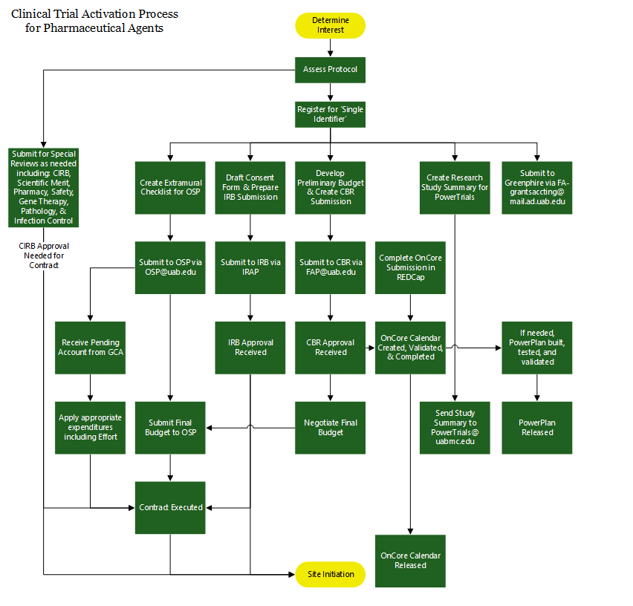
IRAP Project Registration
https://www.uab.edu/research/home/osp-industry-projects/clinical-trials/clinical-protocol-activation-process

Slide 4
