Slide 1
The Gift of Feedback: ALTERing Our Perspective
Melissa M. Carbajal, MD
Gautham Suresh, MD
Department of Pediatrics
Section of Neonatology

Slide 2
Objectives
Recognize a paradigm shift in feedback
List common barriers and recognize common psychological reactions when feedback is received
Demonstrate desirable methods to accept and process feedback

Slide 3
Communication Activity
Pick up your sheet of paper and hold it in front of you.
Close your eyes and follow my directions
Fold your sheet of paper in half
Tear off the upper right-hand corner
Fold it in half again and tear off the upper left hand corner
Fold it in half again and now tear off the lower right- hand corner
Now open your eyes, and let’s see what you have

Slide 4
Traditional Framework
GIVING OF FEEDBACK
RECEPTION OF FEEDBACK
Specific
Timely
Objective
Plan to improve
BARRIERS
ACCEPT
PROCESS
CHANGE
Generic
Delayed
Subjective
No constructive suggestions
DENY
or
DELAY

Slide 5
Fixed vs. Growth Mindset (Carole Dweck)
FIXED MINDSET
GROWTH MINDSET
Intelligence is static
“I am the way I am”
Avoid challenges
Give up easily
Threatened by success of others
Ignore useful negative feedback
Intelligence can be developed
Desire to learn
Embrace challenges
Persist in efforts
Inspired by success of others and find lessons
Learn from criticism
Most of us have both

Slide 6
Fixed vs. Growth Mindset Activity
Self-Assessment

Slide 7
Fixed vs. Growth Mindset
How can we change this?

Slide 8
Self Reflection

Slide 9
Shame

Slide 10
Vulnerability

Slide 11
Vulnerability and Art Activity
Suggestions include
Favorite vacation spot
A dream vacation spot
Someone who is dear to you
A beloved pet
A hobby you are passionate about
A skill you’d like to learn
Your favorite story
Anything real or imaginary you choose

Slide 12
ALTER Framework
GIVING OF FEEDBACK
RECEPTION OF FEEDBACK
Specific
Timely
Objective
Plan to improve
ACCEPT
PROCESS
CHANGE
ALTER
Generic
Delayed
Subjective
No constructive suggestions
x
DENY
or
DELAY

Slide 13
ALTERing Our Perspective
A - Ask
L - Listen
T - Thank
E - Examine
R - Respond

Slide 14
ALTER – Ask Self-assessment alone is not reliable

Slide 15
ALTER – Ask

Slide 16
ALTER – Ask

Slide 17
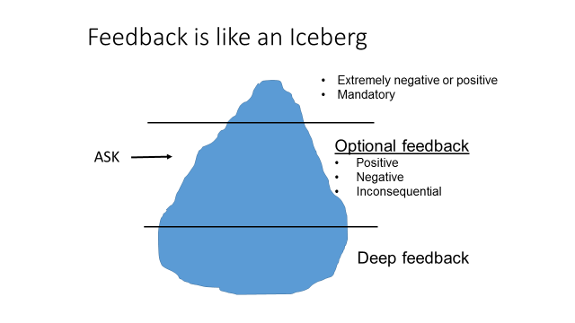
ALTER – Ask What is beneath the surface?

Slide 18
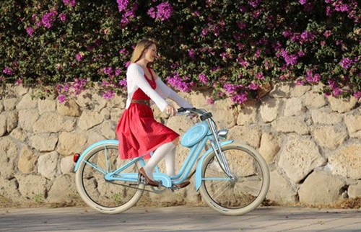
ALTER – Ask Different Types of Feedback

Slide 19
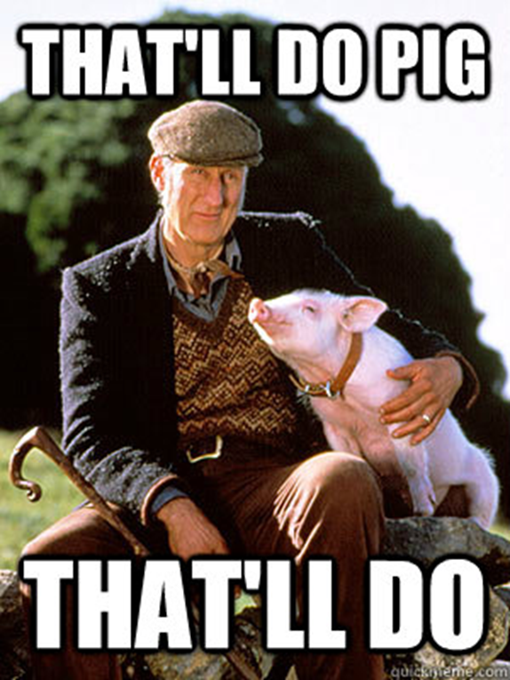
ALTER – Ask Different Types of Feedback
Appreciation

Slide 20
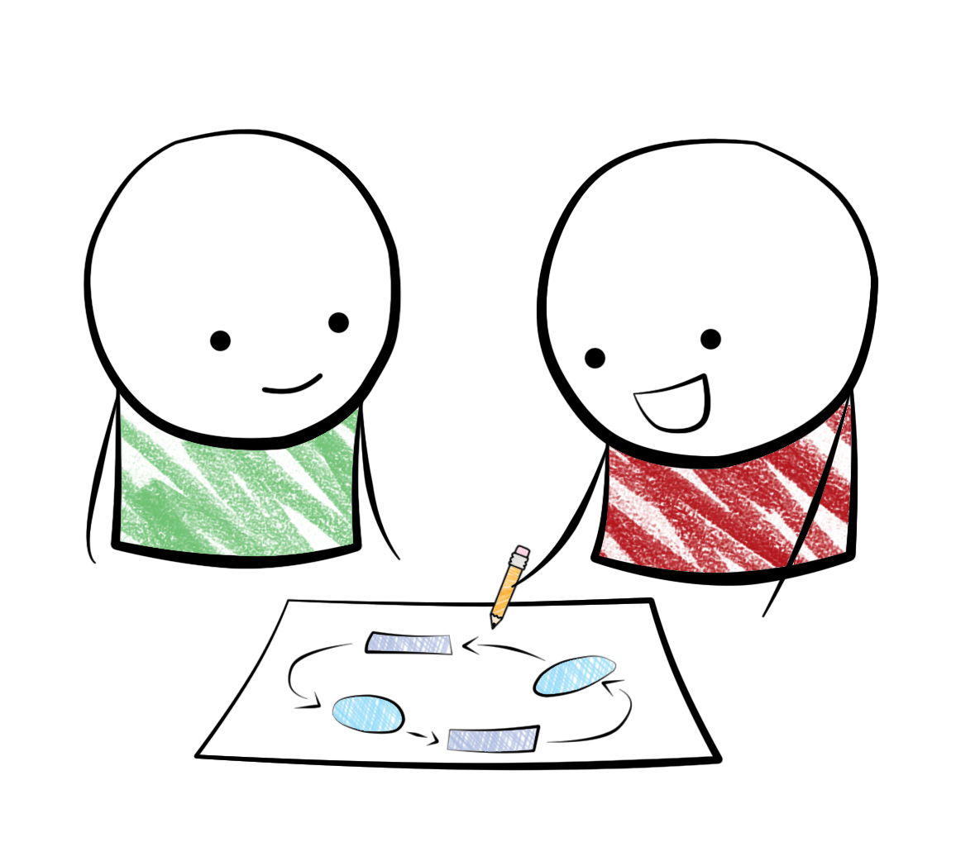
ALTER – Ask Different Types of Feedback
Coaching

Slide 21
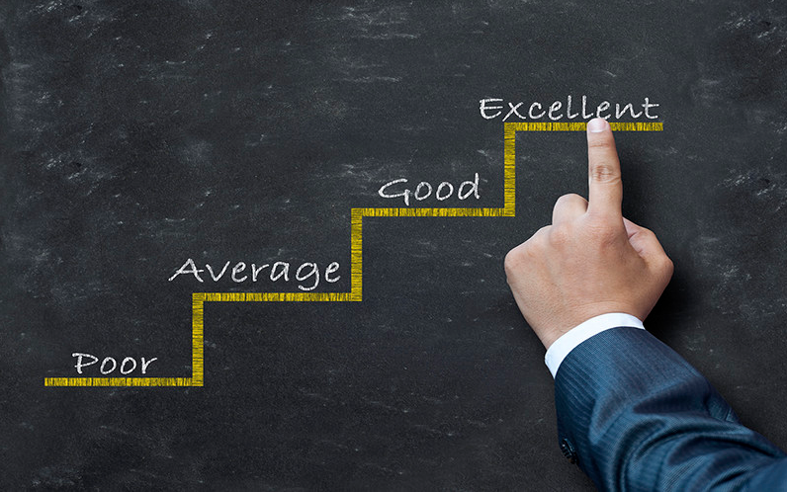
ALTER – Ask Different Types of Feedback
Evaluation

Slide 22
ALTER – AskTypes of Feedback - Review

Slide 23
ALTER – Ask Getting Your Wires Crossed

Slide 24
ALTER – Ask Seeing Clearly

Slide 25
ALTER – Ask Blind Spots

Slide 26
ALTER – Ask Misconceptions

Slide 27
ALTER – Ask Activity
Recall the best Appreciation Feedback you have ever received...did it contain the elements of Quality?
- Was it specific?
- Was it expressed in a way that you valued?
Was it authentic/sincere?
2) When have you avoided Evaluation? How did you receive coaching as a result of your avoidance?
3) What was the most painful Blind-Spot that was ever revealed to you?
Share with your partner...

Slide 28
ALTERing Our Perspective
A - Ask
L - Listen
T - Thank
E - Examine
R - Respond

Slide 29
ALTER – Listen Common Problems with Listening
Completing sentences
Interrupting
Hijacking (including ‘me too’ stories)
Planning response
Impatiently waiting for your turn

Slide 30
ALTER – Listen Avoid behaviors that prevent you from listening

Slide 31
ALTER – Listen Common Problems with Listening

Slide 32
ALTER – Examine Activity
Scripted Role Play

Slide 33
ALTERing Our Perspective
A - Ask
L - Listen
T - Thank
E - Examine
R - Respond

Slide 34
ALTER – Thank See feedback as a gift

Slide 35
ALTER – Thank
Provides positive reinforcement
More feedback during current interaction
Encourages future feedback
Has to be authentic

Slide 36
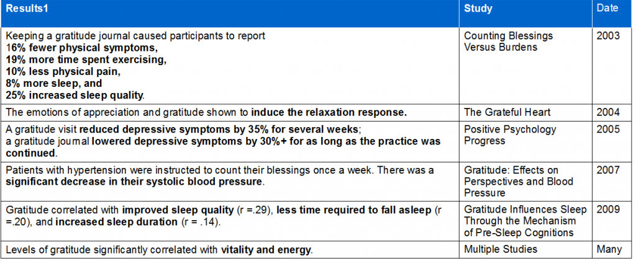
ALTER – Thank Benefits of Gratitude
http://happierhuman.com/benefits-of-gratitude/
http://www.forbes.com/sites/amymorin/2014/11/23/7-scientifically-proven-benefits-of-gratitude-that-will-motivate-you-to-give-thanks-year-round/#369aa6826800

Slide 37
ALTER – Thank Benefits of Gratitude
http://happierhuman.com/benefits-of-gratitude/

Slide 38
ALTERing Our Perspective
A - Ask
L - Listen
T - Thank
E - Examine
R - Respond

Slide 39
ALTER – Examine Barriers to Accepting Feedback
Relationship between giver and receiver
Belief about intent of feedback
Intrinsic desire to improve

Slide 40
ALTER – Examine Commit to finding the truth

Slide 41
ALTER – Examine Be aware of influences you

Slide 42
ALTER – Examine Handout
Worksheet Guide for
Examining Feedback

Slide 43
ALTERing Our Perspective
A - Ask
L - Listen
T - Thank
E - Examine
R - Respond

Slide 44
ALTER – Respond Make change

Slide 45
ALTER – Respond Accountability
Share Feedback with a mentor or an accountability partner.
Set goals to implement the feedback using a time-line
Ask mentors and friends to keep you on track

Slide 46
ALTER – Respond Decline
Vulnerability + Quest for Truth + Desire to Improve
=
The ability to respectfully decline feedback

Slide 47
ALTERing Our Perspective
A - Ask
L - Listen
T - Thank
E - Examine
R - Respond

Slide 48
Questions?

