Slide 1
Case-based learning (CBL) in Large enrollment classes: A how-to Seminar
UAB Medical Educator Series
Will Brooks, PhD
wbrooks@uab.edu

Slide 2
What is CBL?
Using a case-based approach engages students in discussion of specific situations, typically real-world examples. This method is learner-centered and involves intense interaction between the participants. CBL focuses on the building of knowledge, and the group works together to examine the case. The instructor’s role is that of a facilitator, and the students collaboratively address problems from a perspective that requires analysis. Much of CBL involves learners striving to resolve questions that have no single right answer. (Queen’s University, 2011)

Slide 3
History of CBL
Harvard
  Law school adopted case method in 1870
  Harvard Business School adopted across curriculum in 1920
  Still in use today at both
Widely used in varying disciplines across the country
  Medicine
  Health professions
  Business
  Law
  Education
Also known as: case method, case study method

Slide 4
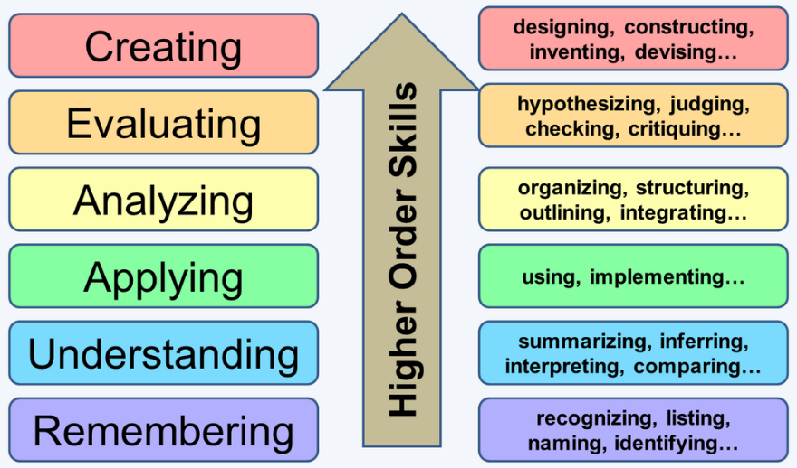
General Features of CBL
Based on specific learning objectives
  Often higher level Bloom’s Taxonomy
Uses complex, real-world, clinical cases to provide students the opportunity to:
  Apply knowledge
  Critically analyze data
  Evaluate decisions
  Design alternative solutions

Slide 5
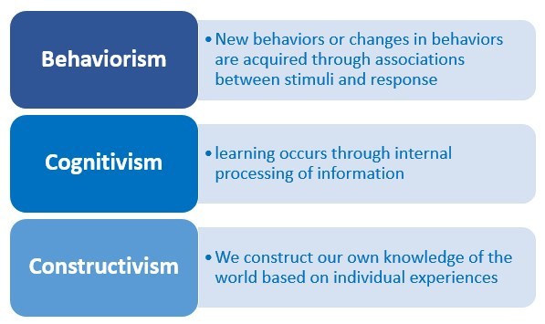
General Features of CBL
Rooted in Constructivist Learning Theory
Pre-class preparation
In-class active discussion

Slide 6
CBL Cases
Cases should:
  Be authentic
  Involve common scenarios
  Tell a story
  Be aligned with learning objectives/outcomes
  Have educational value
  Stimulate interest
  Create empathy with the characters
  Include quotations in character voice to create drama and realism
  Have general applicability

Slide 7
Forms of CBL
Small group CBL
  1 facilitator + small group of students (<12)
Large group CBL
  1 facilitator + large group of students (12 - 100+)
  Individual or team

Slide 8
Harvard Business School Case Method

Slide 9
We’re Just Wasting Our Time

Slide 10
Large Group CBL
Open with a warm call
Ask a combination of focused and open-ended questions to guide discussion toward learning objectives
Use board/PPT to keep track of “pastures”
Explore objectives fully, sum-up, move on
End with resolution…what actually happened…may not have been the best resolution!

Slide 11
Resources
The effectiveness of case-based learning in health professional education. A BEME systematic review: BEME Guide No. 23. Medical Teacher 2012.
Christensen Center for Teaching & Learning http://www.hbs.edu/teaching/resources/Pages/default.aspx
  Elements of Effective Class Participation
  Characteristics of Effective Case Teaching
  Questions for Class Discussion

