Slide 1
UAB PeopleAdmin Training
Faculty Search Committees
Office of the Provost, Faculty Affairs
Notes:
This training module/session serves as a how to guide to assist faculty search committees and search committee chairs with navigating UAB PeopleAdmin – the university’s faculty jobs system.

Slide 2
Message
UAB Faculty Search Committees,
Please follow these steps to login to UAB PeopleAdmin, the Faculty Recruitment System. You will review faculty candidate materials such as the Curriculum Vitae, cover letter, teaching statements, research statements, and other application materials that are required for the search.
If your search committee has opted to use the evaluation tool in the system, you can evaluate candidates at different steps in the search process.
Thank you.

Slide 3
What can you do as a Search Committee Member?
As a Search Committee Member, you can:
  View faculty requisitions
  View application materials
  Print application materials
  Evaluate applicants/candidates, if evaluative criterion is available for your search.
Notes:
This guide shows you how to login into the system, view faculty candidate applications and documents, such as the CV, letter of recommendation, and research or teaching statements. The committee decides which documents or media is required from candidates.

Slide 4
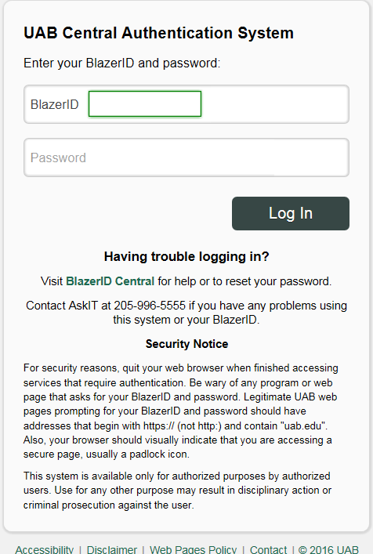
How to login
http://www.uab.edu/facultyjobs/admin
Login using your BlazerID and password
This will take you to your UAB Faculty Jobs (PeopleAdmin) homepage/dashboard
Notes:
Search Committee members should login to UAB PeopleAdmin from the link in the email that you received from the system; or you can login from the UAB AdminSystems page. It is important to remember to login through the Single-Sign On SSO using your BlazerID & password.

Slide 5
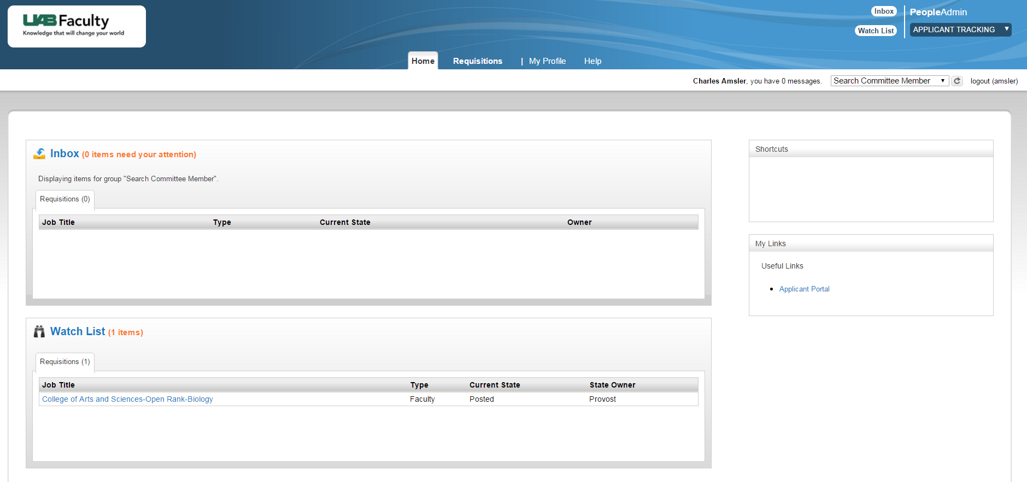
Home Page
User Role
Inbox
My Links
Watch List
Watch List
Notes:
Once you login, you will be on your dashboard or homepage. See the upper right-hand corner to make sure you’re logged in as a Search Committee Member. You may have additional roles in UAB PeopleAdmin (i.e. Equity Advisor).

Slide 6
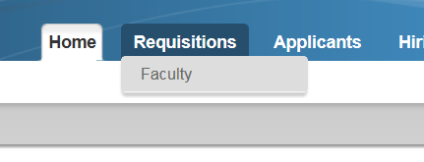
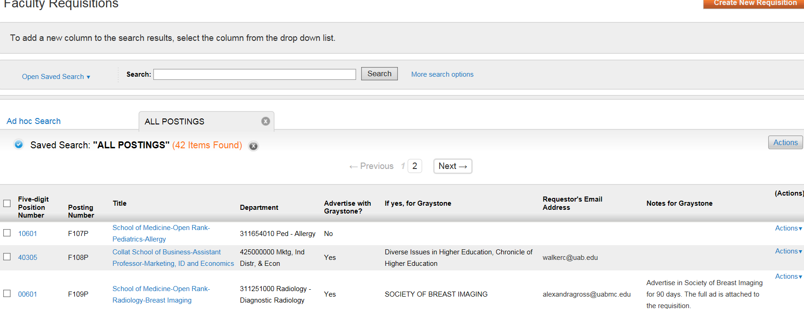
How to View A Requisition
1.Hover over Requisitions and select FACULTY group from the drop-down menu.
2. A listing of positions that the Search Committee Member has access to will be visible under the Ad Hoc Search
Notes:
To view the requisition(s) that you are assigned to, CLICK on Requisitions from the BLUE Navigation Bar on your homepage.
You’ll select Faculty from the dropdown list. Any search/requisition that you are assigned to should be visible on this page.

Slide 7
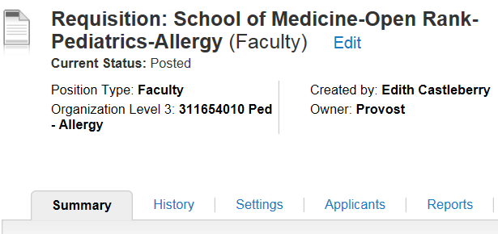
Viewing Candidate Application & Materials
Once you have selected the position in which you would like to begin reviewing and/or evaluating applicants, from the Requisition Summary, click on the APPLICANTS tab.
Notes:
Once you have accessed the requisition, open it to view candidates who have applied for the position. Click on the APPLICANTS tab to see a list of applicants.

Slide 8

Viewing Candidate Application & Materials
From this screen, you can perform a variety of activities:
  Review all submitted application materials for an applicant by hovering over ACTIONS at the end of the row of an applicant and click on View Application:
  This includes reviewing CV, application, cover letter, etc.
Notes:
From the applicant list, select the candidate(s) you want to review. CLICK on the candidate’s last name to open and view the complete application. Or, you can select a specific document to view for the candidate.

Slide 9
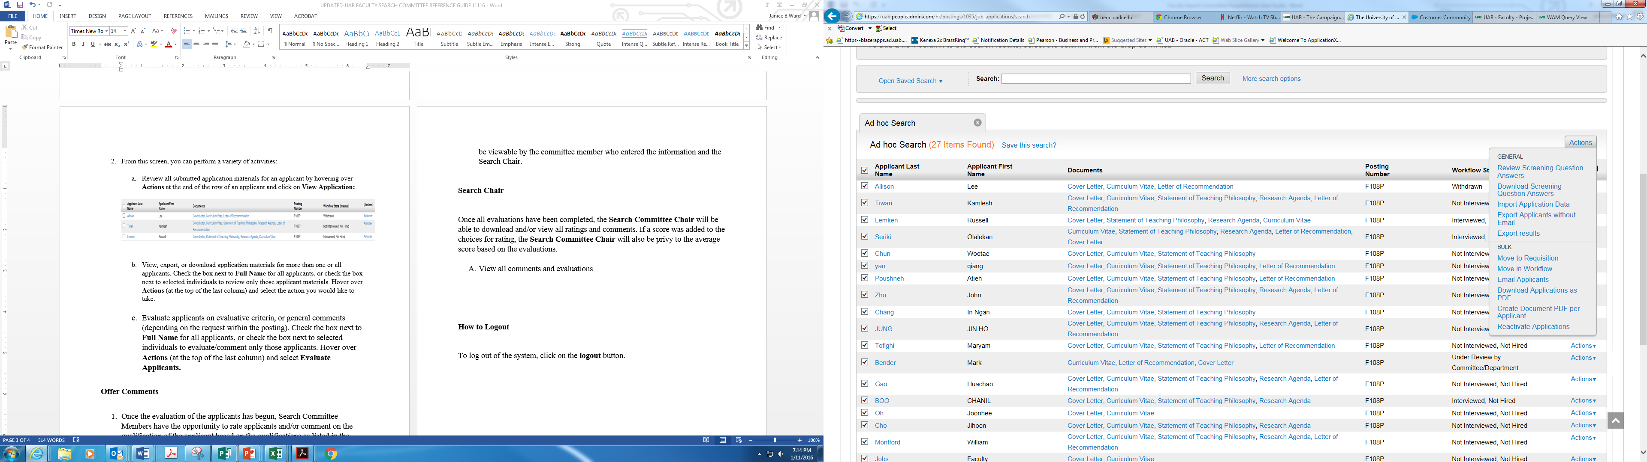
Viewing Candidate Application & Materials
  To view, export, or download application materials for more than one or all applicants. Check the box next to Applicant Last Name for all applicants, or check the box next to selected individuals to review only those applicant materials. Hover over Actions (at the top of the last column) and select the action you would like to take.
Notes:
You can download applicant materials if you’d like to email or print them as a PDF.

Slide 10
Search Committee Member Comments
Once the evaluation of the applicants has begun, Search Committee Members have the opportunity to rate applicants and/or comment on the qualifications of the applicant based on the qualifications as listed in the job posting.
To rate an applicant, Search Committee Members will be given questions, if setup during the creation of the posting.
Comments are also allowed by entering the desired information in the Comment field. Comments will only be viewable by the committee member who entered the information and the Search Committee Chair.

Slide 11
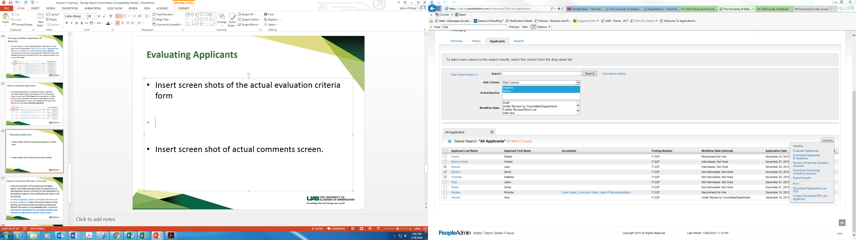
How to Evaluate Applicants
  To evaluate applicants on evaluative criteria, or general comments (depending on the request within the posting). Check the box next to Last Name to select all applicants, or check the box next to selected individuals to evaluate/comment only those applicants. Hover over Actions (at the top of the last column) and select Evaluate Applicants.
Notes:
The next three slides demonstrate how to evaluate candidates. Keep in mind that your committee may have decided to evaluate candidates using a different tool.

Slide 12
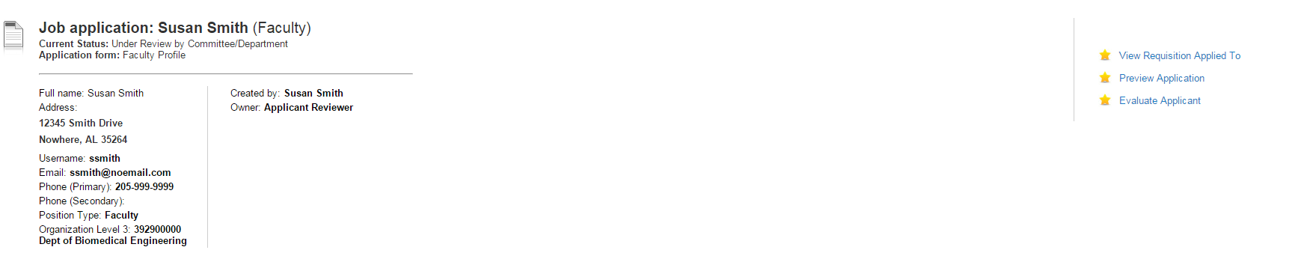
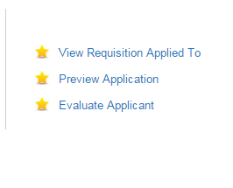
How to Evaluate Candidates (continued)
Once you have selected the candidate you want to evaluate, you will click on “Evaluate Applicant” as shown below.
Notes:
As you evaluate candidates, it’s important to note that only the Search Committee Chair can view the evaluations of all committee members. This allows committee members to objectively evaluate candidates.

Slide 13
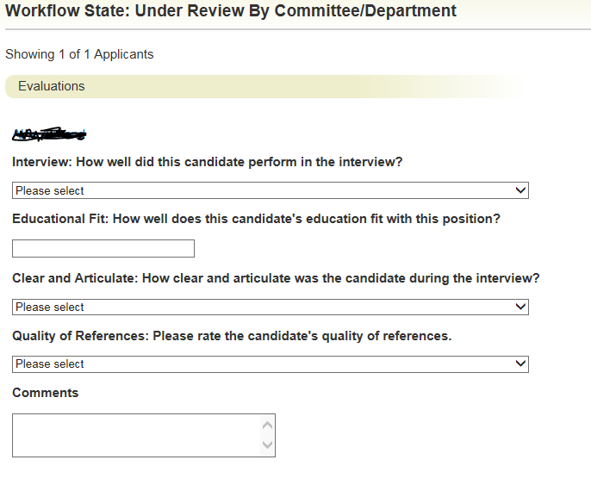
How to Evaluate Candidates (continued)
Note: Evaluation Questions/Criterion may vary by search. Each search committee will determine what questions should be included in the evaluation criterion.
General comments and feedback can be added in the Comments Box located below each evaluative criterion.
Notes:
Note: Faculty Affairs can assist search committees with creating evaluation criteria for each search.

Slide 14
Search Committee Chair
  As Search Committee Chair, you can:
  View faculty requisitions
  View application materials
  Print application materials
  Evaluate applicants/candidates, if evaluative criterion is available for your search.
  View comments and evaluations from search committee members.
Notes:
If you are chairing the search, you can access candidate evaluations and comments from your search committee members.

Slide 15
Questions?
Please contact Faculty Affairs at facultyaffairs@uab.edu or call (205) 934-0513 for assistance.

