Slide 1




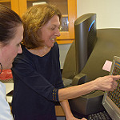
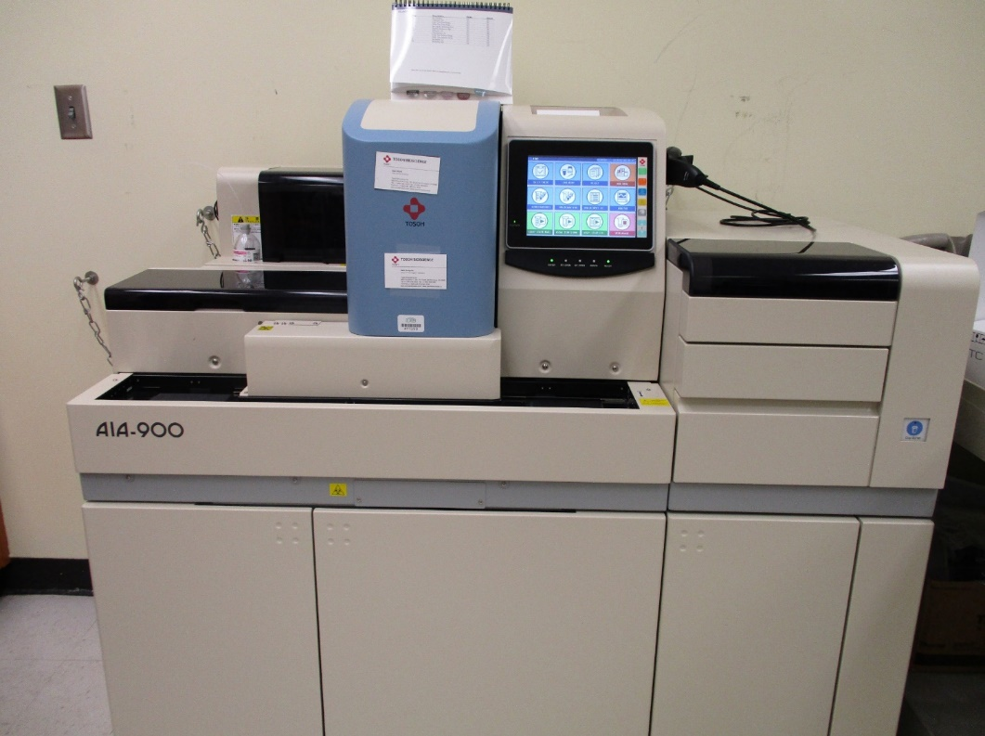
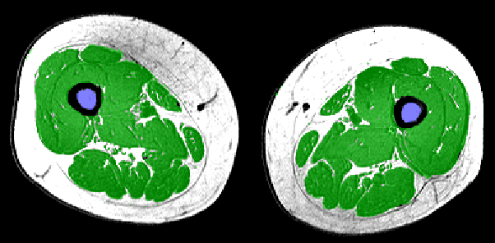
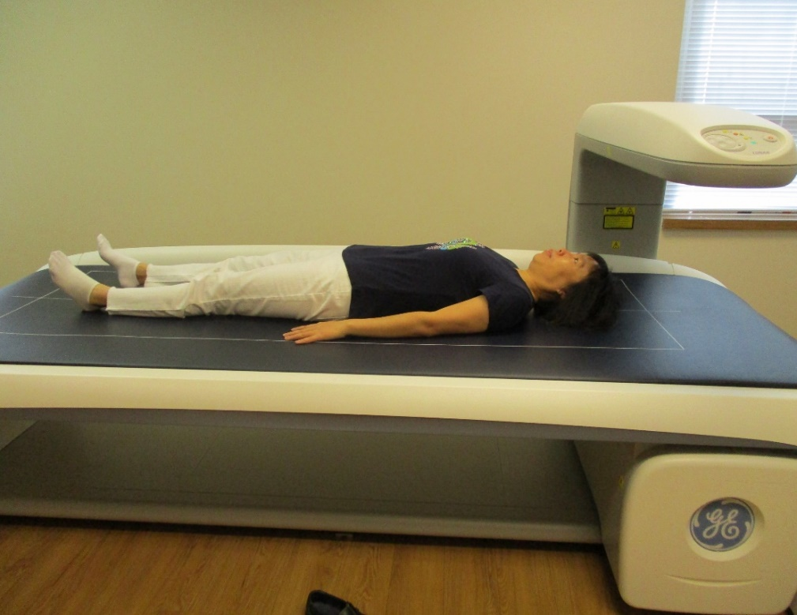
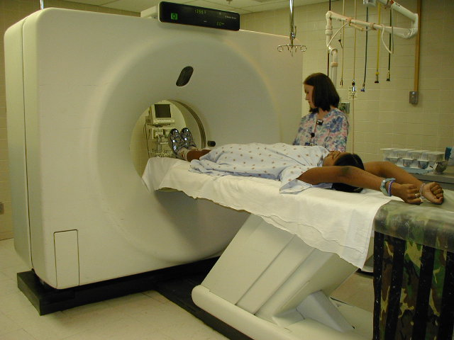
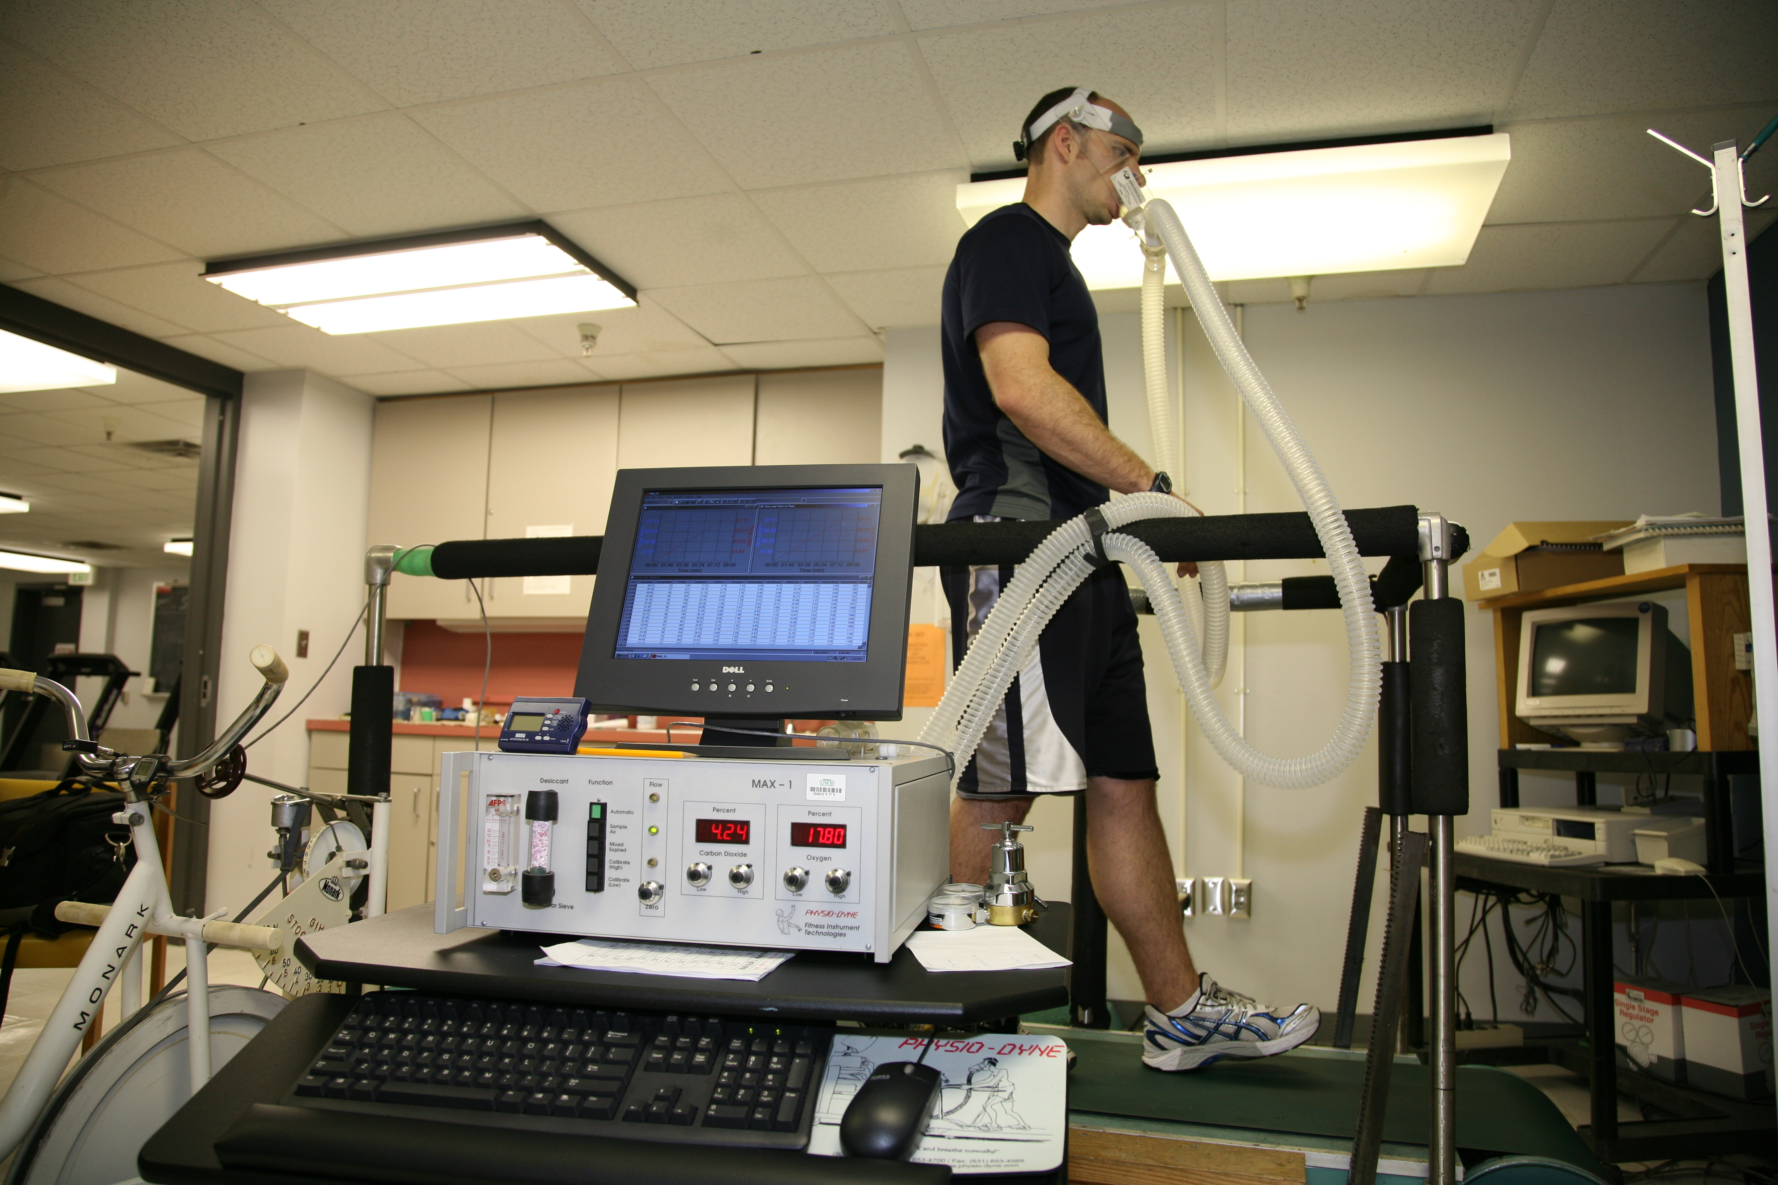
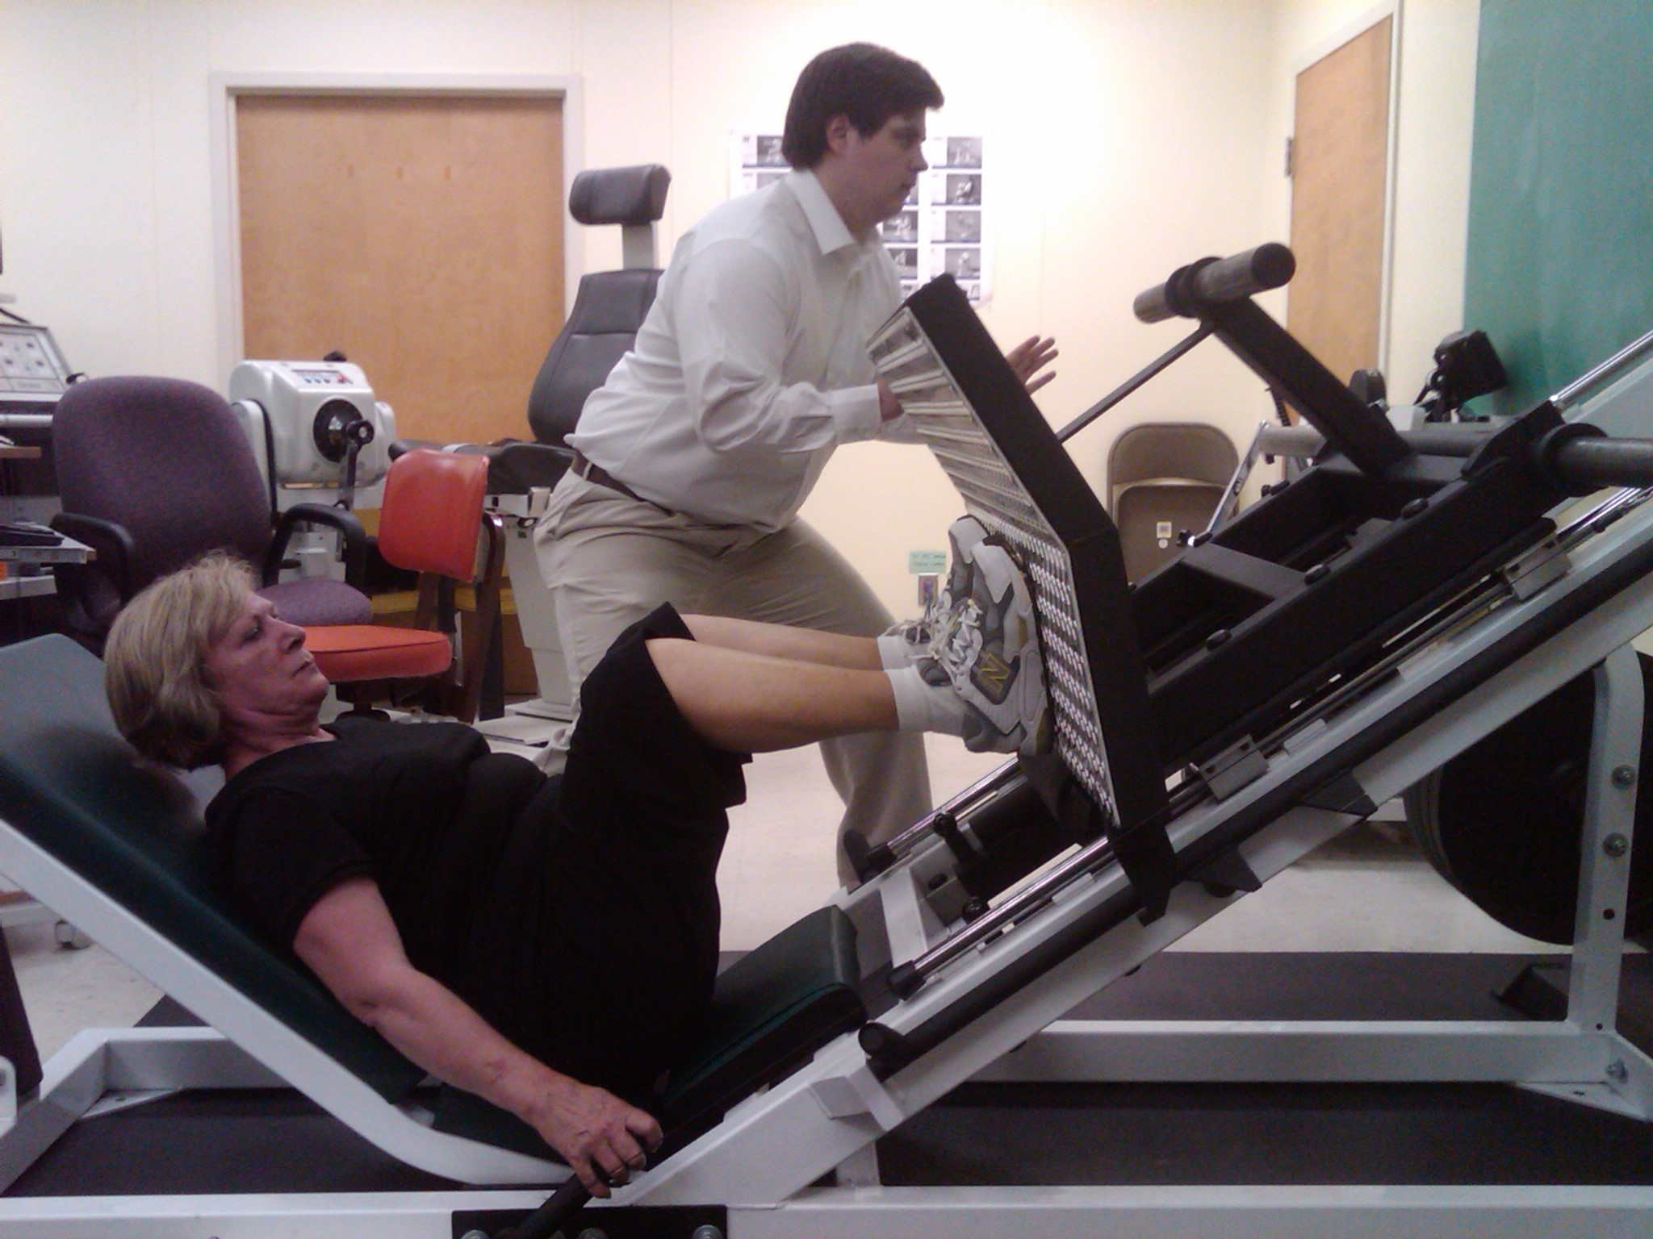
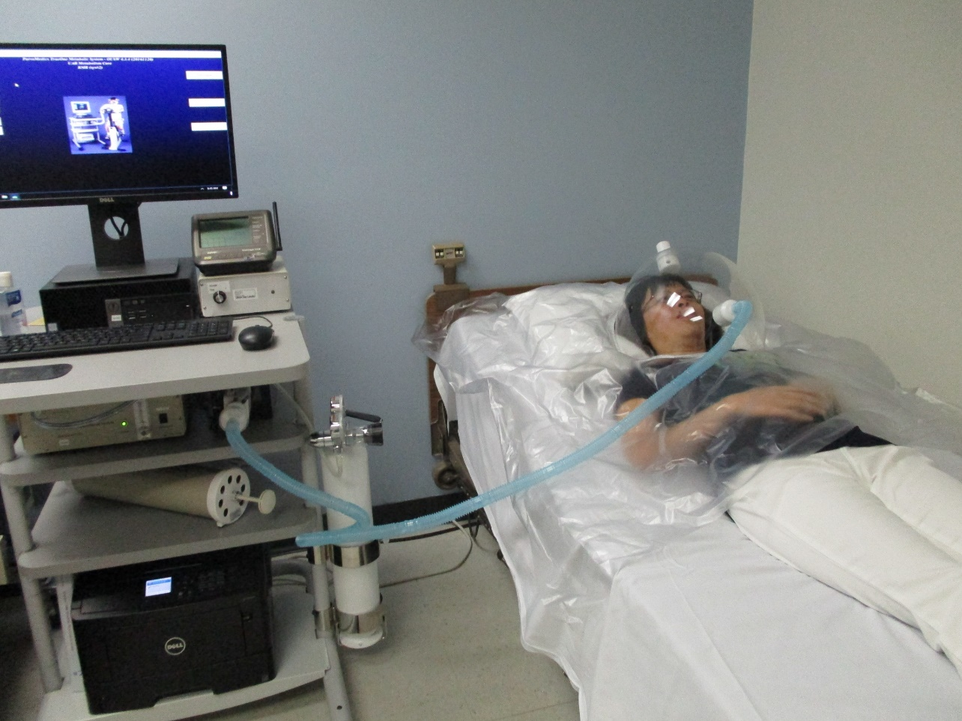
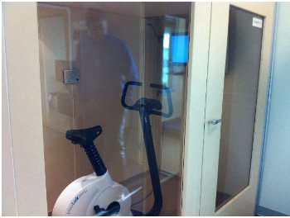
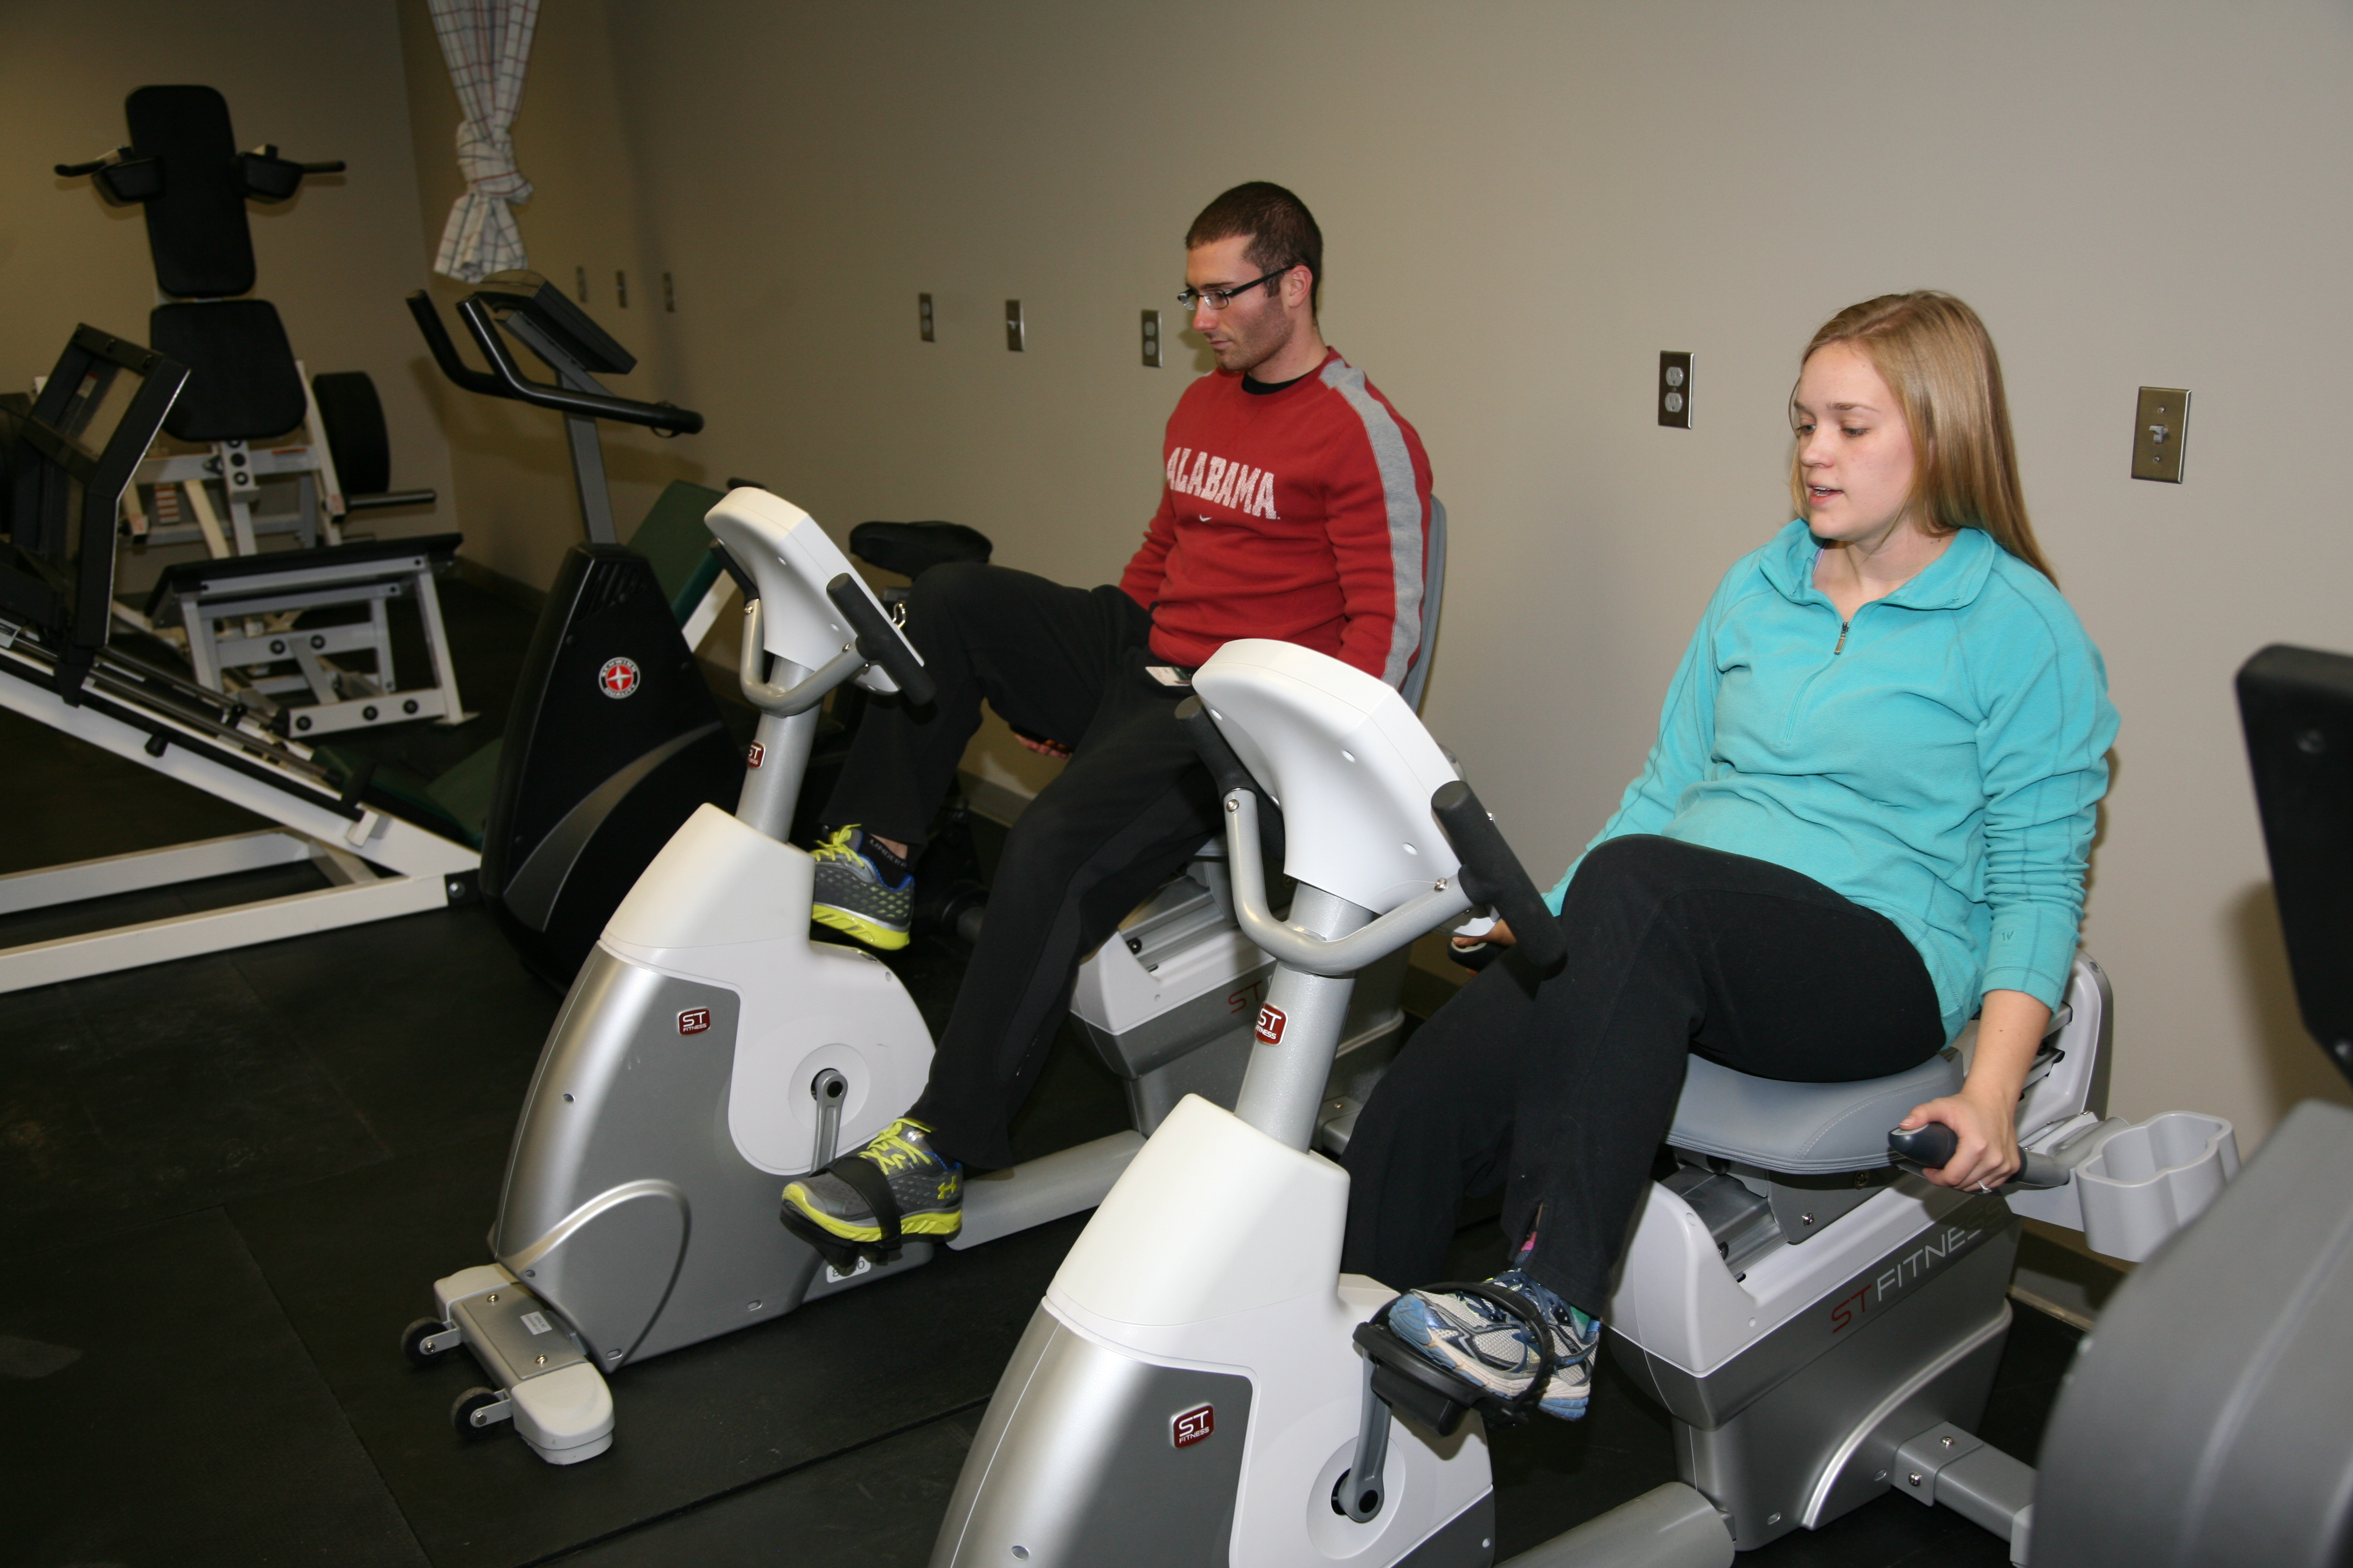
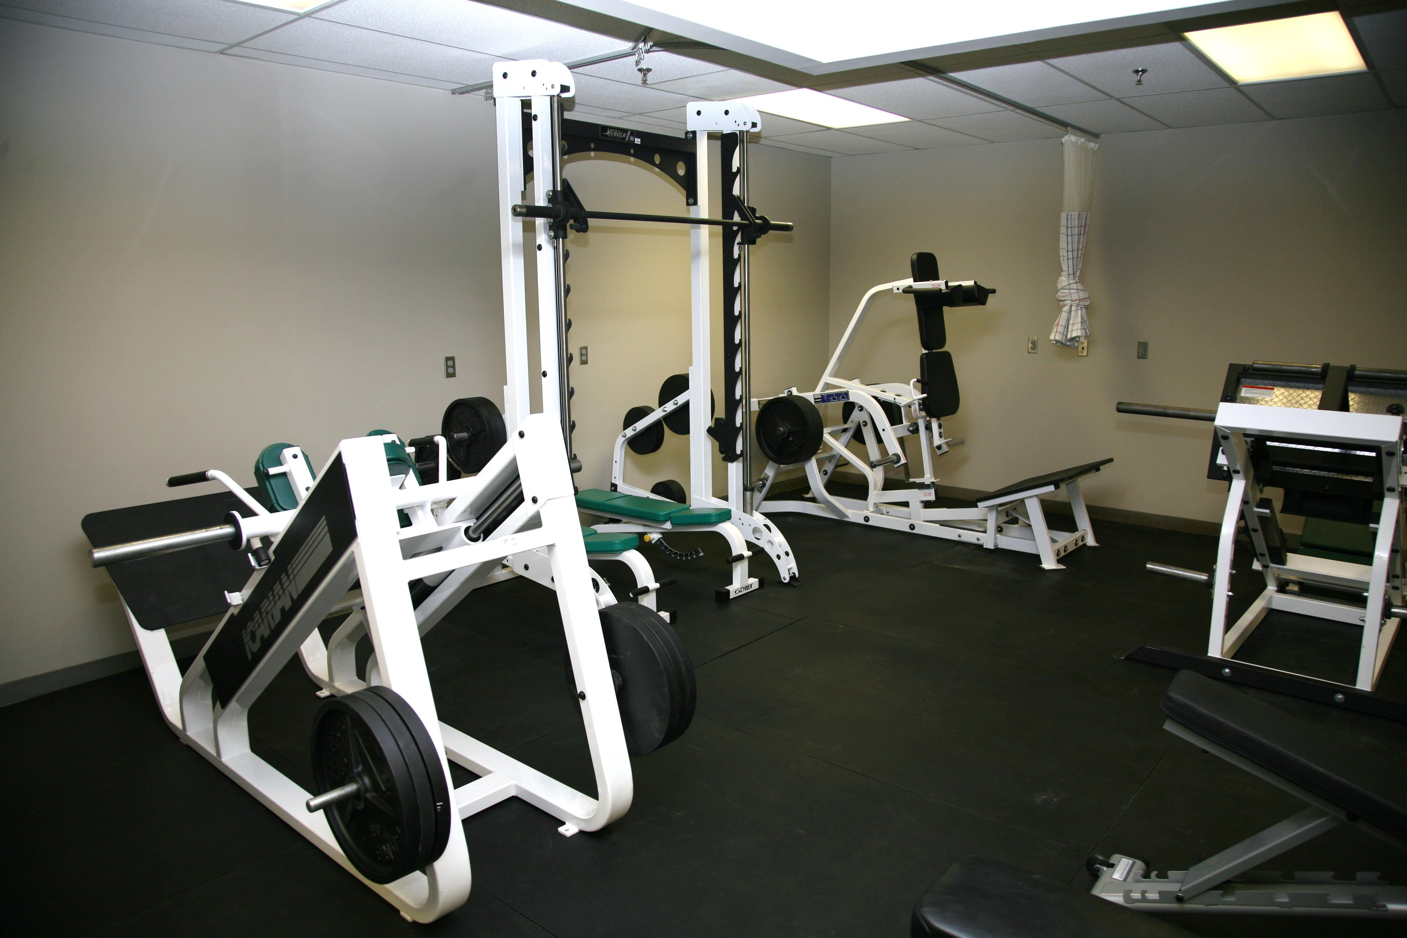
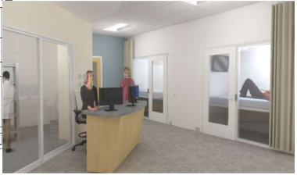
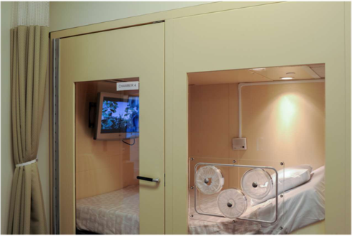

Metabolism Core
Institutional Research Core Facilities (IRCP)
I. Hormones/analytical
Hormones
Cytokines
Glucose
A1C
Lipids
Multiplex (MSD)
FDA certified analyzers
ELISA
RIA
Human/animal
III. Energy Expenditure
Doubly-labeled water
Total energy expenditure
Activity-related EE
Free-living (2 weeks)
Indirect calorimetry
Canopy: Resting EE
Whole-room
New, state of the art calorimetry chambers
Flex room for short tests
Large chamber for long daytime/overnight tests
Pediatric chamber
Total, resting, sleeping EE
Substrate oxidation
Exercise metabolism
Postprandial metabolism
Physical Activity
VO2 MAX
Submaximal exercise testing
Strength tests
Functional testing
EMG measurement of ease during standing, walking, carrying
Supervised resistance or aerobic training for individuals or small groups
Accelerometry
Arterial elasticity testing
Hypoxia testing
Grant preparation assistance
Consultation with researchers
V. Body Composition
Dual-energy X-ray absorptiometry (DXA)
Total fat, lean, bone mass
Bone density
Visceral fat
CT/MRI scan analysis
Fat distribution
Regional tissue composition
Total body water
BIA
II. Insulin sensitivity/secretion
Insulin sensitivity
Intravenous glucose tolerance test (IVGTT)
Mixed meal tolerance test (MMTT)
Oral glucose tolerance test (OGTT)
Mathematical modeling
β-cell response to glucose
IVGTT, OGTT, MMTT
Mathematical modeling
Core Personnel and Contact Information
Director: Dr. Barbara Gower
bgower@uab.edu, 934-4087
Analytical (Webb 337):
Heather Hunter hlhunter@uab.edu
Cindy Zeng
Nikki Bush
Jono Blackburn
Body Composition/Energy Expenditure:
Heather Hunter
Kat Sweatt
Physical Activity (Webb
David Bryan dbryan@uab.edu

