Slide 1

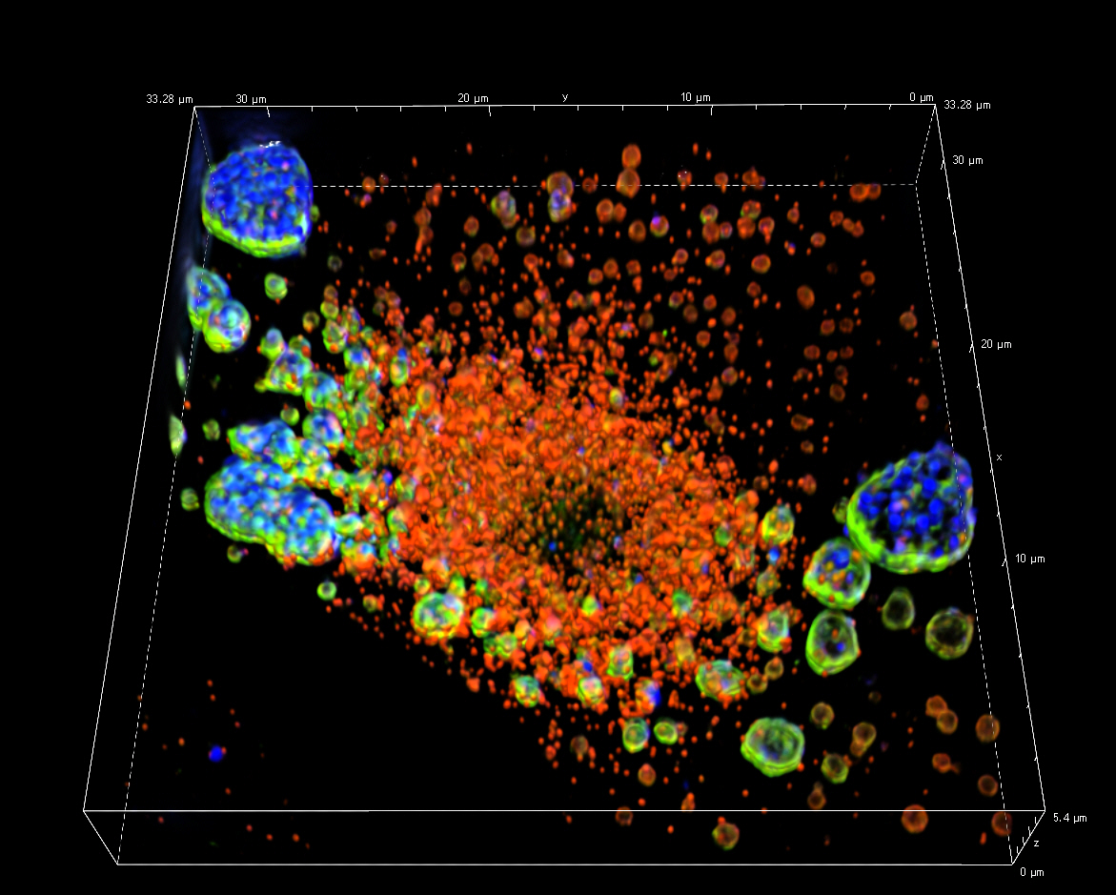
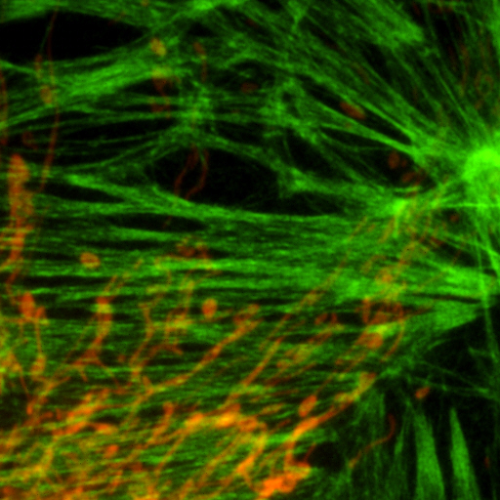
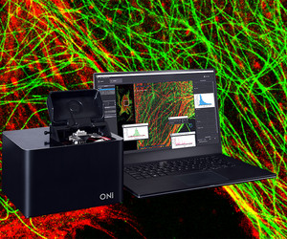
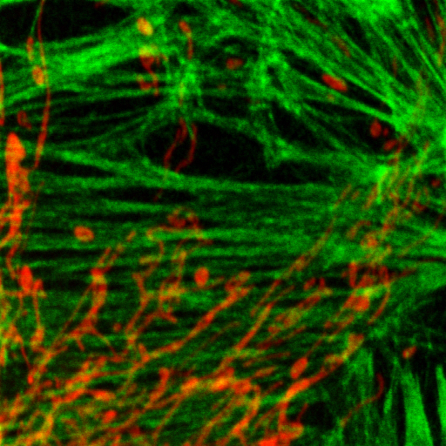
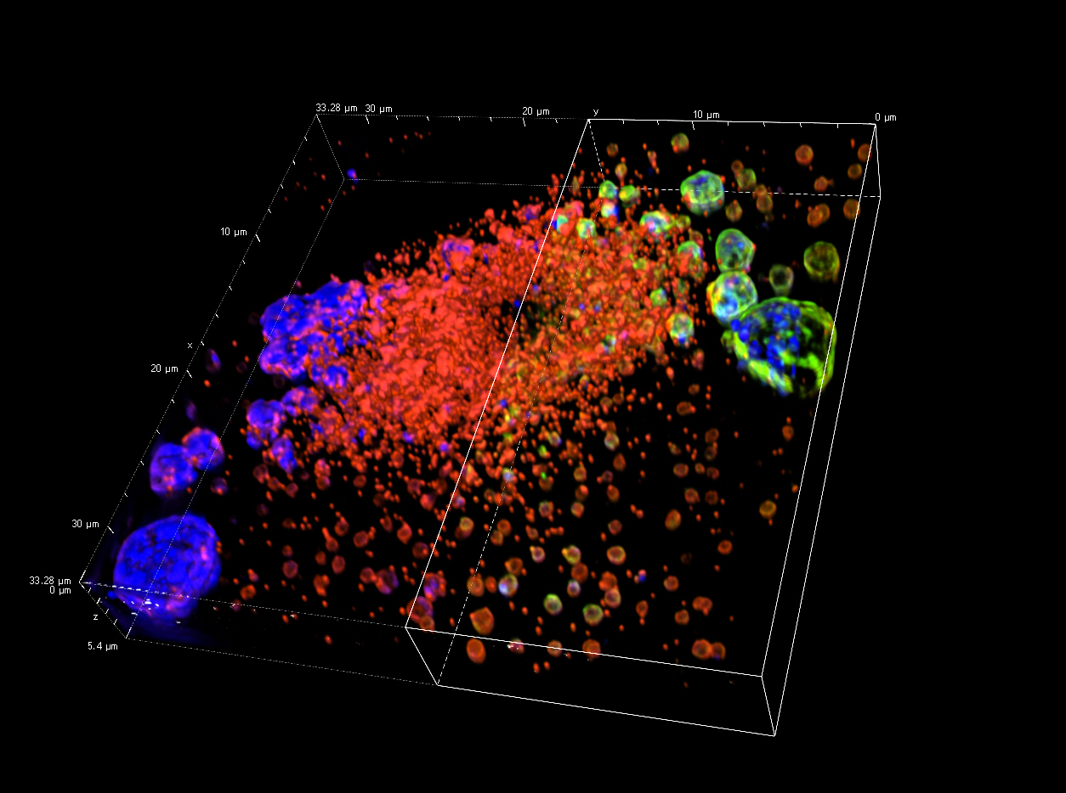
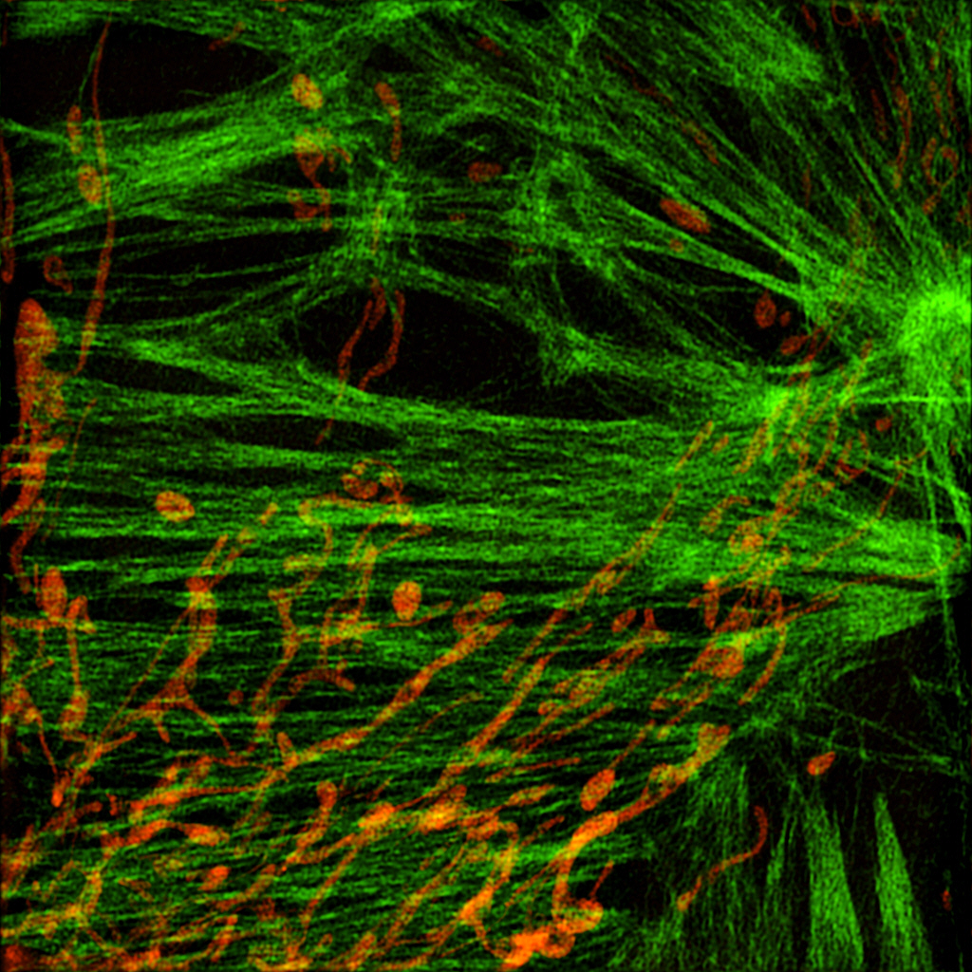
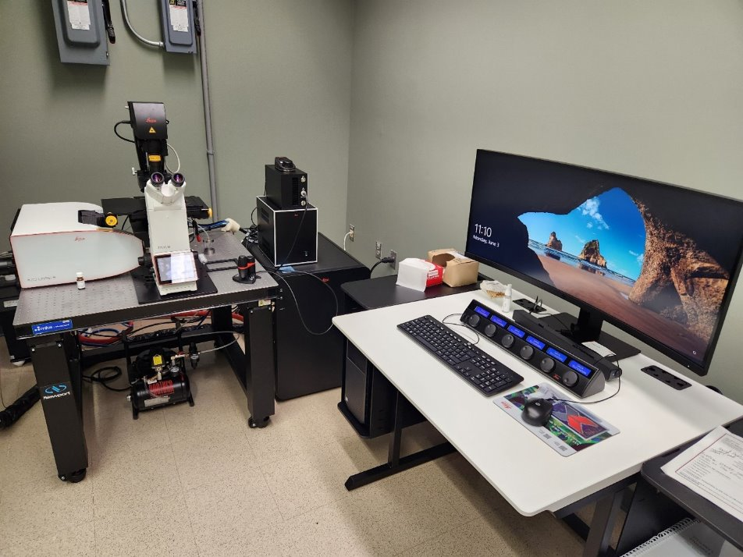
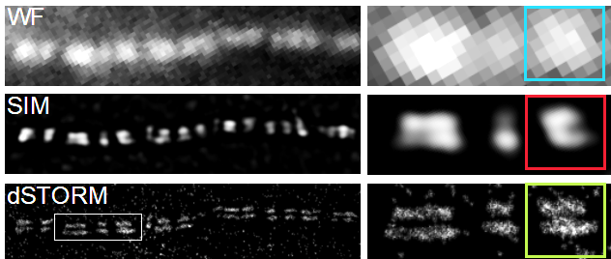
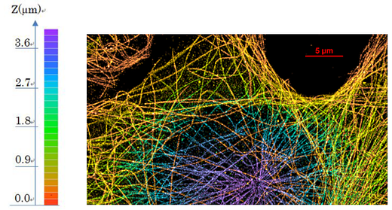
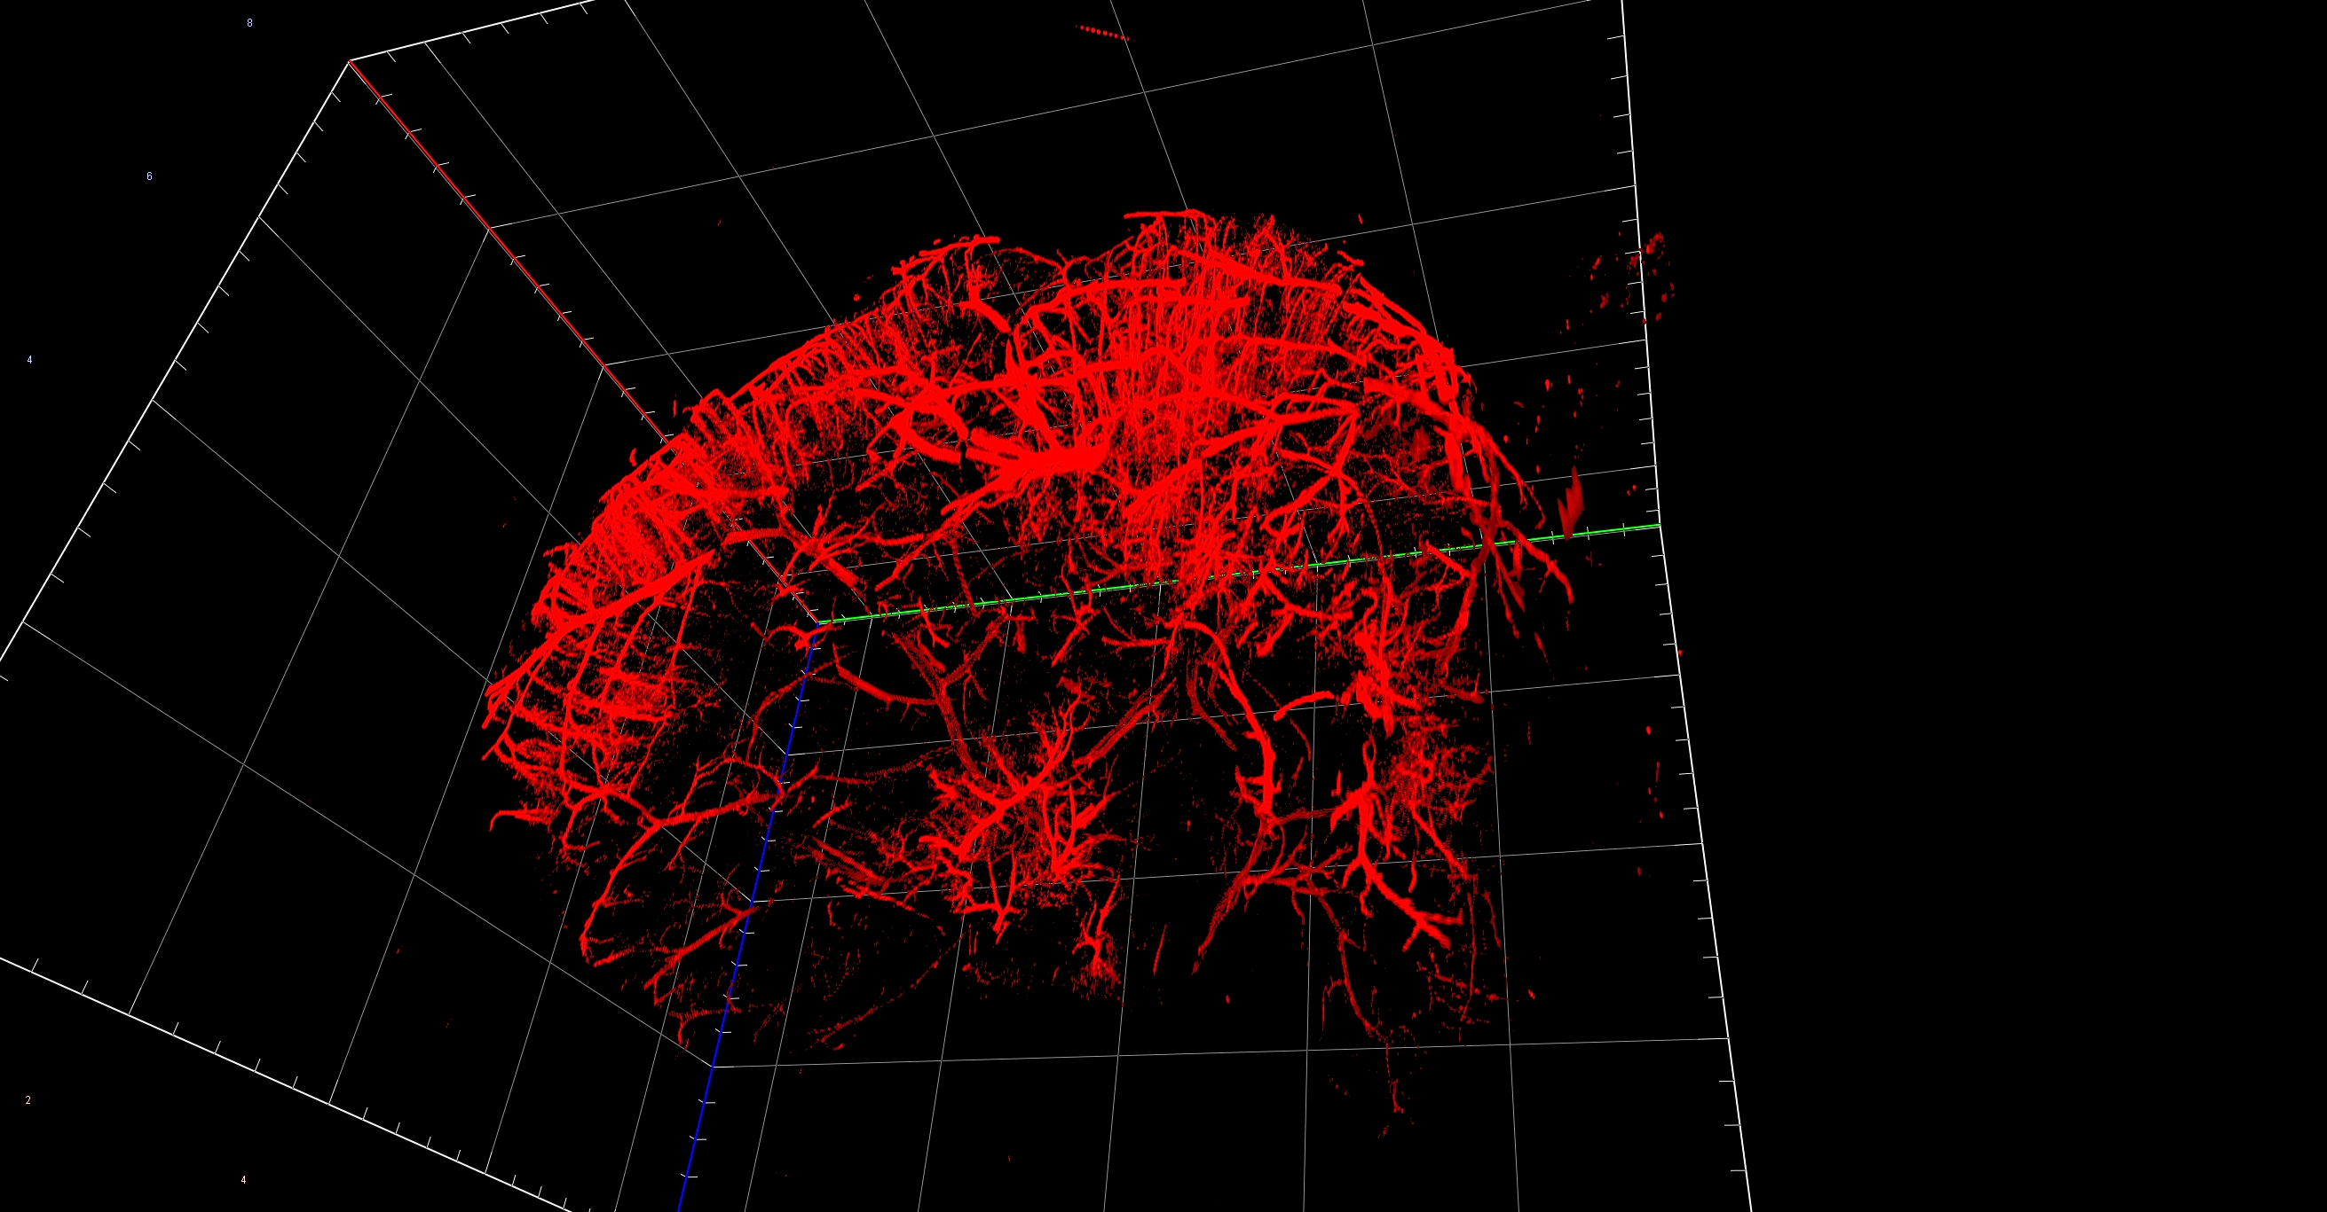
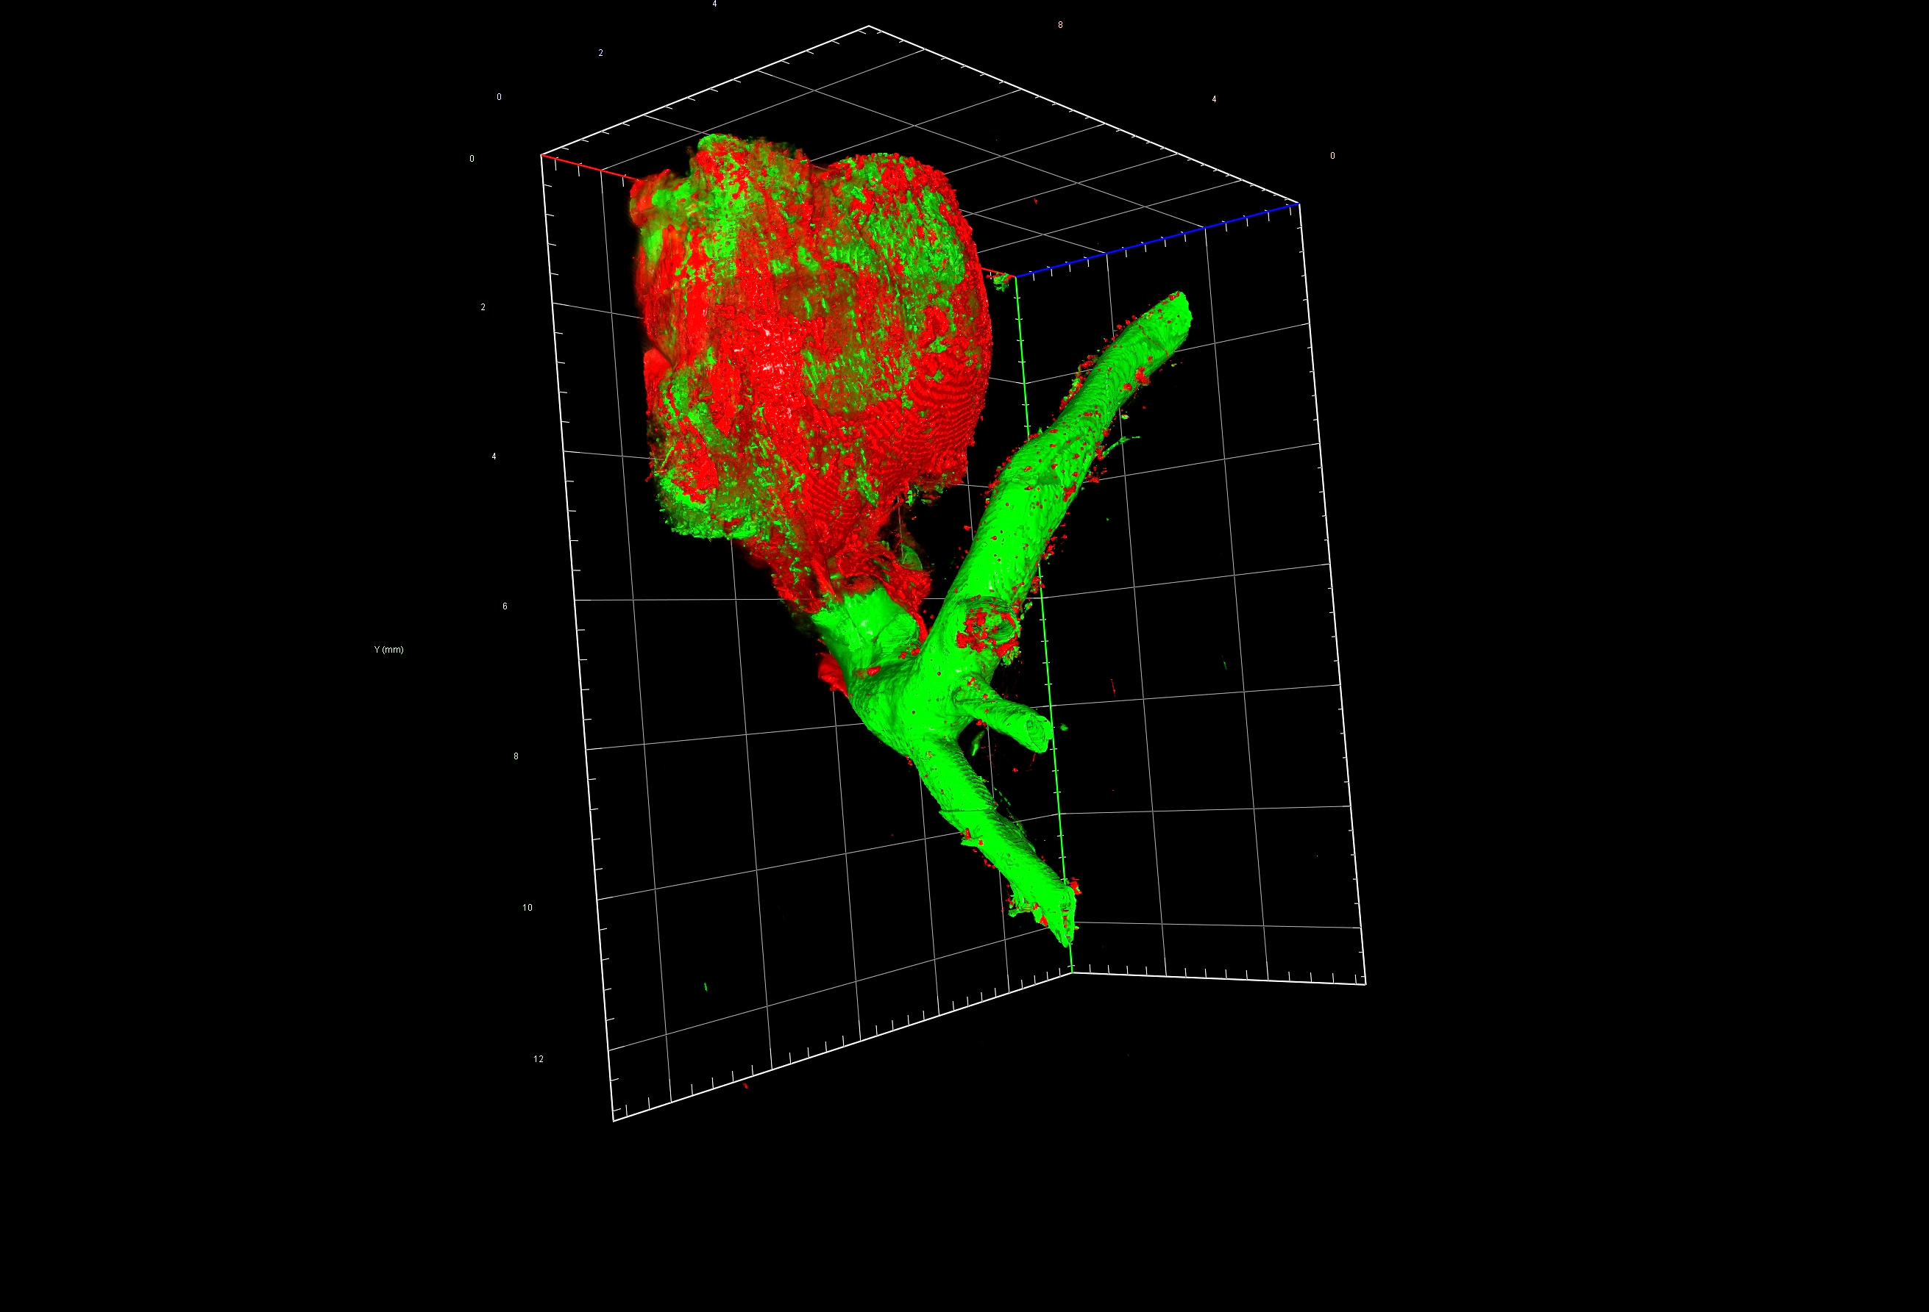
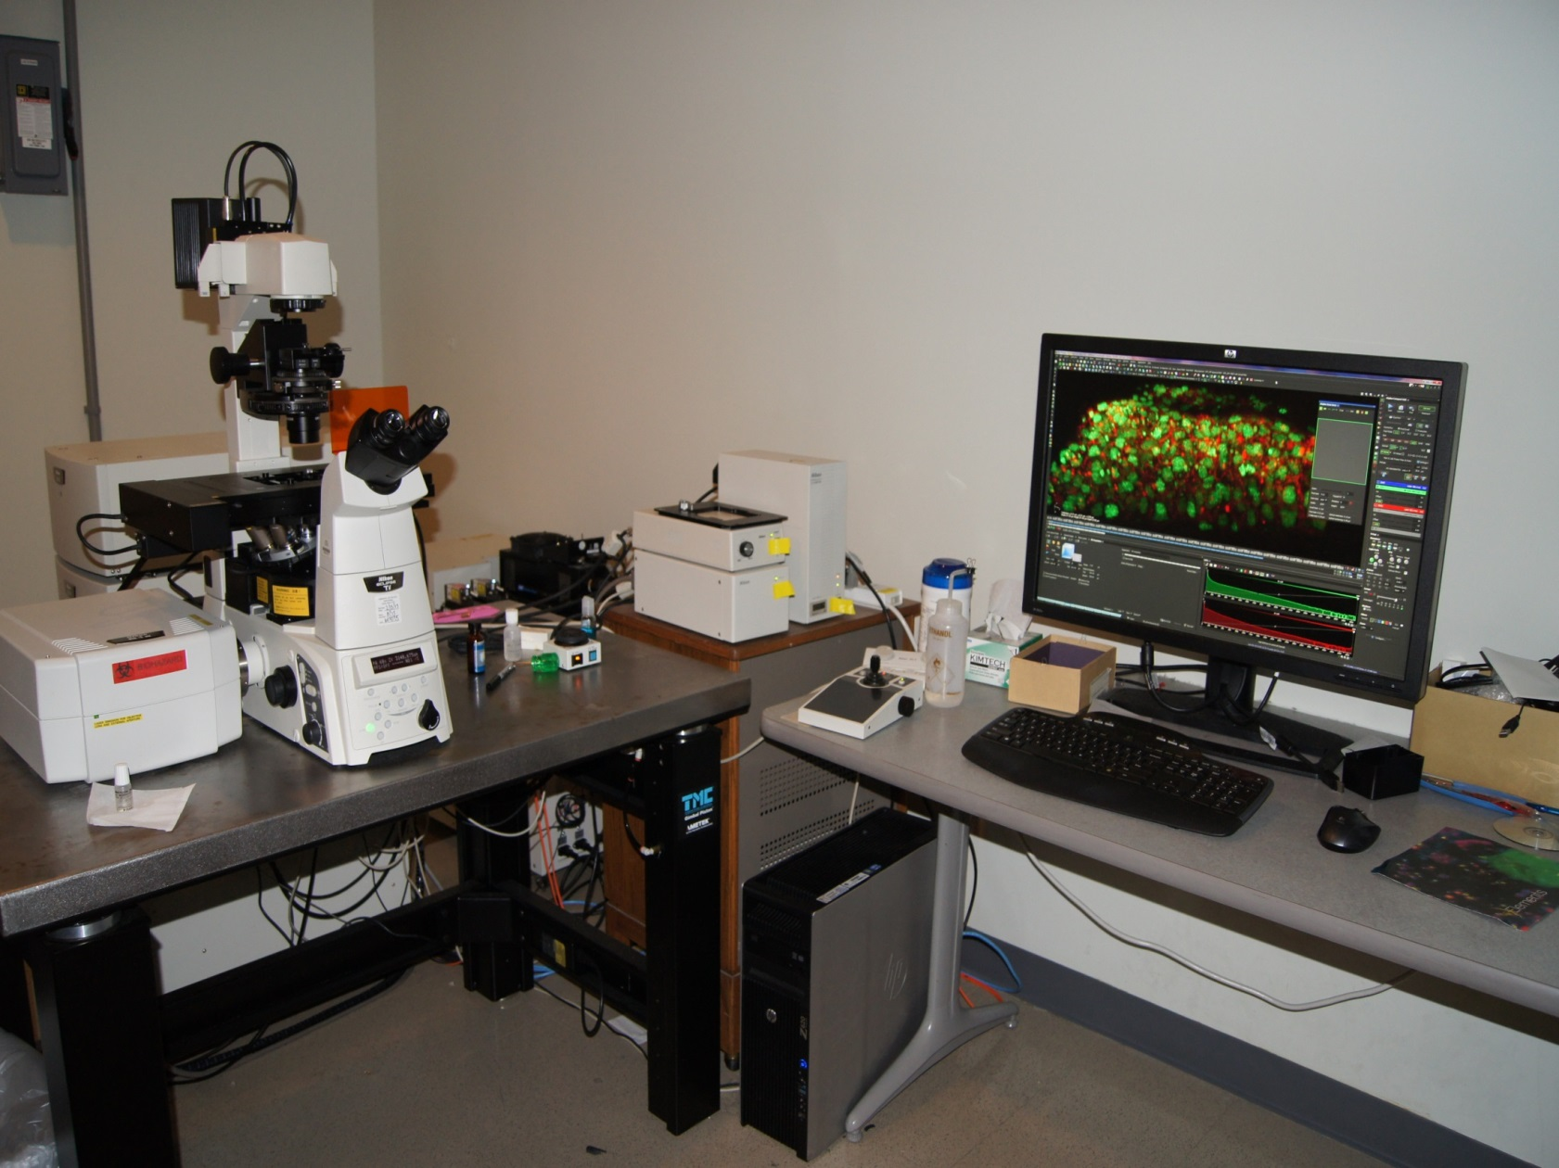
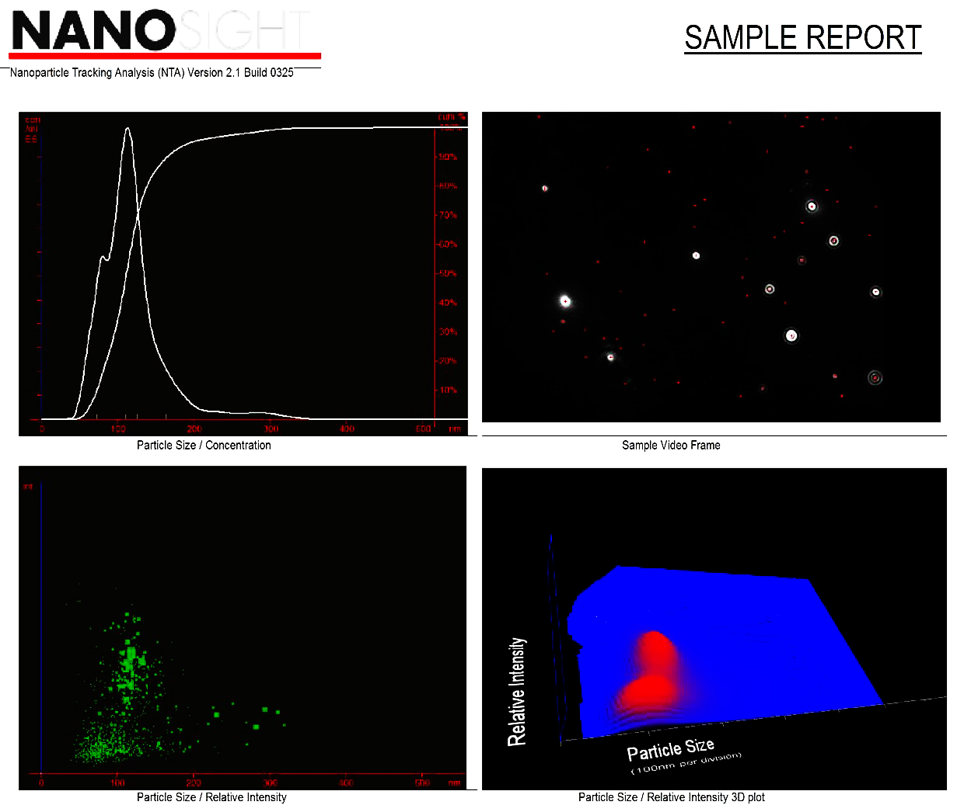
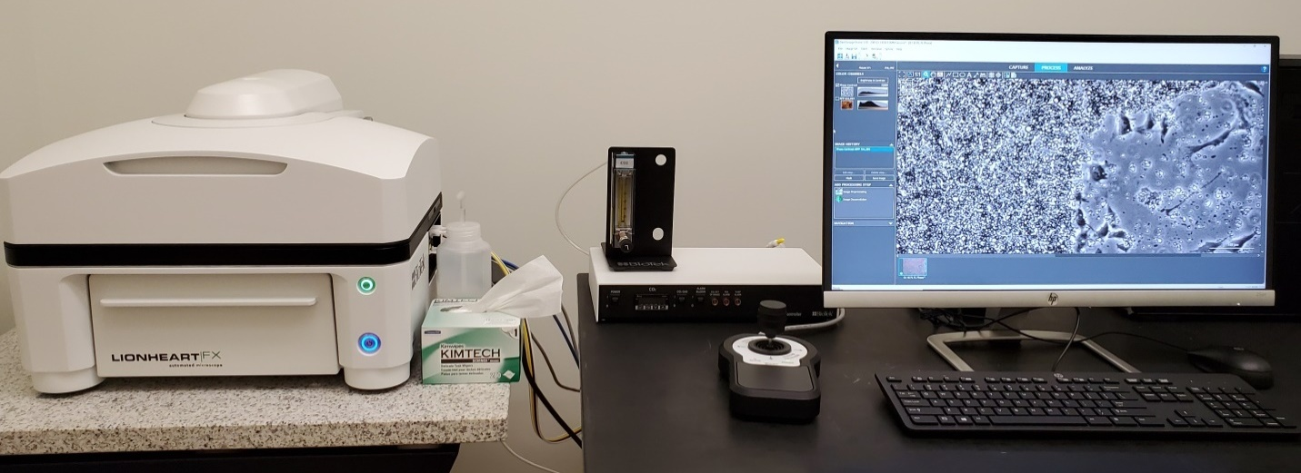
INSTITUTIONAL RESEARCH CORE PROGRAM
HIGH RESOLUTION IMAGING FACILITY
FLUORESCENCE MICROSCOPY
SUPER RESOLUTION MICROSCOPY
ONi NANOIMAGER
CONFOCAL MICROSCOPY
Widefield
ONi Nanoimager
Capabilities: dSTORM, PALM, PAINT, SPT and smFRET imaging.
Applications: The ONI Nanoimager is used for super-resolution imaging of cellular structures, protein localization, and molecular complexes, as well as single-particle tracking, colocalization analysis, and studying molecular interactions and dynamics in fixed and live cells, including applications in cell biology, neuroscience, virology, and nanotechnology.
Leica Stellaris 5 Confocal Microscope
System: Advanced imaging on a DMI8 base with LAS X Software.
Capabilities:
  Detectors & Lasers: 4 Power HyD® S detectors, tunable White Light Laser (485–790 nm), extended detection to 850 nm, AOBS®.
  TauSense®: FLIM-based photon counting technology.
  Imaging: DIC, fluorescence, color brightfield, and large-scale image stitching with LAS X Navigator.
Structured Illumination Microscopy (SIM)
Resolution: Twice the diffraction limit (~115 nm lateral, ~269–300 nm axial).
Capabilities: Enables detailed 3D visualization of intracellular structures in fixed/live cells and tissues, with optical sectioning for higher spatial resolution.
Confocal
SIM
LIGHTSHEET MICROSCOPY
Bartle et al. JCS 2016
Stahley et al, JCS 2016
https://www.nikoninstruments.com/Products/Super-resolution/N-STORM-Super-Resolution
STochastic Optical Reconstruction Microscopy (STORM)
Resolution: Tenfold improvement (~20 nm lateral, ~50 nm axial).
Capabilities: Reconstructs super-resolution 3D images using precise fluorophore localization. Supports multi-color imaging for 2–3 proteins at the nanoscale.
Zeiss Lightsheet 7 Microscope
Purpose: Fluorescent imaging of live or fixed-cleared whole organisms and organs.
Capabilities: Fast, gentle imaging of living models (e.g., zebrafish, organoids) over time and large cleared specimens with subcellular resolution. Adapts to various clearing methods with specialized optics and sample chambers.
Mouse brain vasculature and mouse aorta imaged at HRIF core facility. Courtesy of Daniel Tyrrell Ph.D.
NANOPARTICLE IMAGING SYSTEM
NS300 Particle/Exosome Analysis System
Capabilities: Visualizes and measures particles (10–2000 nm) in suspension.
Applications: Protein aggregation, exosomes, drug delivery systems, nanomaterial characterization, and fluorescent particle analysis (488 nm excitation).
HISTOLOGY & WIDEFIELD FLUORESCENCE
Lionheart FX Epifluorescence Microscope
Versatility: Compact system supporting basic and advanced imaging techniques.
Capabilities: Live/fixed specimen imaging in chamber slides, dishes, and plates. Offers color/BW brightfield, fluorescence, and phase-contrast imaging.
HRIF Laser Scanning Confocal Microscopes
Systems: Three confocal microscopes for fixed/live cell and tissue imaging.
Capabilities: 4-channel imaging (405/488/561/647 lasers), high-speed resonance scanning (up to 420 fps), perfect focus for timelapse, live cell chamber (CO2/temp control), spectral detection/unmixing, FRAP, FRET, photoactivation, 2D/3D imaging, calcium imaging, colocalization, GaAsP detectors.
HRIF Sponsors
UAB Institutional Research Core Program (IRCP)
Comprehensive Cancer Center (P30 CA013148)
Lightsheet - S10 OD032341
Veteran’s Administrative Hospital Research Division
Alexa Mattheyses, PhD, Director
(205) 975-0680
mattheyses@uab.edu
Melissa Chimento Associate Director
(205) 934-1926
mchimento@uab.edu
Robert Grabski, PhD
Imaging Specialist (205)-934-7039
rgrabski@uab.edu
Shawn Williams
Imaging Specialist
(205)-934-7403
tzaron@uab.edu
Ed Phillips
Research Associate
(205) 934-1926
ephillips@uab.edu
To schedule time on a microscope or to schedule a training session with HRIF specialist, visit us at:
www.uab.edu/HRIF
Alison Margolies
Scientist I
(205) 934-1926
kamargo@uab.edu

