Slide 1

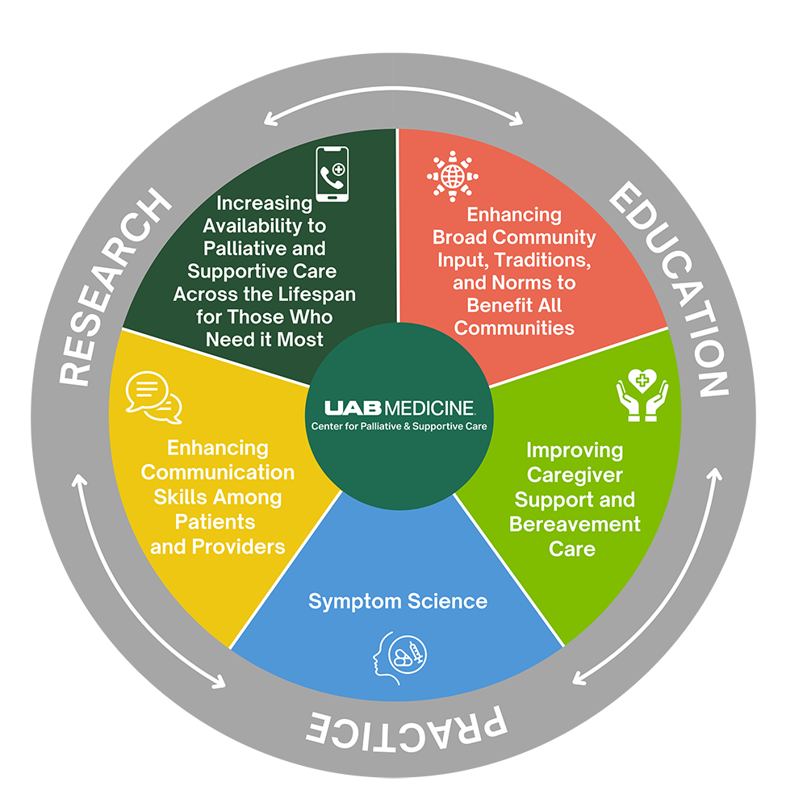




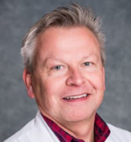
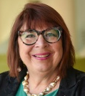
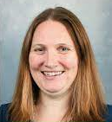
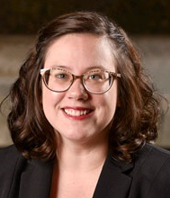
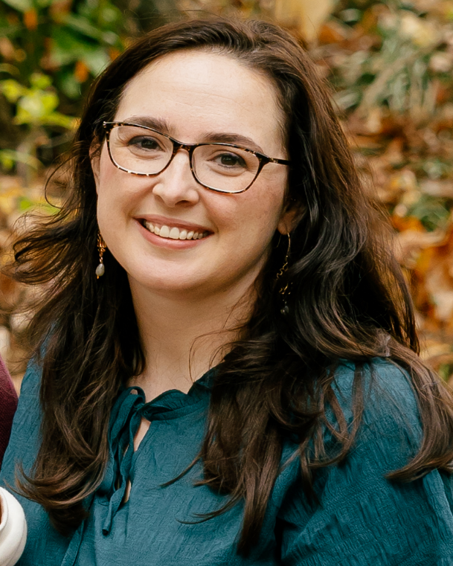

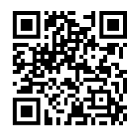


Center for Palliative and Supportive Care UWIRC
Mission
We serve patients and families experiencing serious illness by providing compassionate clinical care, demonstrating leadership in teaching health professionals and trainees, conducting collaborative research, and influencing health care delivery and public policy.
Vision
To become an international center of excellence in through personalized care, innovative approaches and sharing expert knowledge.
CPSC Research Core Themes
Education & Training
1 of only 9 designated US PC training institutions.
80 MD/DO physicians trained in Hospice & Palliative Medicine
81 Psychology/Counseling graduates and post graduate students
Over 5100 individual learners participated in educational experiences with the CPSC since 2000.
25 difference training experiences/programs offered for a variety of interdisciplinary team members.
Research
Seminar Series
We host monthly research meetings to provide:
Knowledge, experience, guidance, and mentorship to investigators.
Opportunities for researchers to present ideas and get input from others.
Open to ALL interested in enhancing their research skills (i.e., faculty, fellows, post-docs, graduate students, & research staff)
Center Scholars
Membership cultivates innovation & collaboration to advance palliative care
research across & beyond UAB.
Senior Scientist, Scientist, Associate Scientist, and Affiliate appointments are based on shared interest in palliative & supportive care.
Center Scholars are invited to participate in CPSC activities to develop innovative and creative approaches to palliative and supportive care research.
UWIRC Leadership
Palliative Research
Enhancement Projects
Palliative Care Research Consultation Office Hours
We fund UAB investigators in innovative research contributing to the palliative & supportive care evidence base to serve as pilot data for future external funding. Since 2014, PREP has awarded $569,017 to 30 projects.
Dr. Rodney
Tucker
CPSC
UWIRC
Director
Dr. Marie
Bakitas
Associate
Director
for Research
Dr. Emily
Johnston
Director,
Pediatric Palliative Research
& Education
Dr. Rachel
Wells
CPSC
Faculty Development Coordinator
Racheal
Nerud, MBA
Program
Director
for Research
Monthly, virtual meetings designed to provide a supportive space to talk through focused research questions at any stage of your work. These hours are ideal for:
Research proposal or study-development questions
Feedback on abstracts, posters, etc.
Troubleshooting project-related challenges
PREP awardees with project-specific questions that would benefit from additional perspective.
Letters of Intent Due: January 26th at 5:00pm Special Call This Year:
Community Agency Partnerships
Interested in learning more? Visit our webpage or contact
Racheal Nerud at rachneru4673@uabmc.edu.

